Slide 1

Blockchain Dictionary Project
Created for Beginner and Intermediate learners
Includes visuals, definitions, and video resources
Goal: Simplify blockchain concepts
Name – Deepak Barwal
Id- 101531741

Slide 2

Alt coin
Beginner:Any cryptocurrency that is not Bitcoin. They may offer different features, like faster transactions or privacy tools. Examples include Ethereum, Litecoin, and Solana.
Intermediate: An altcoin refers to any cryptocurrency other than Bitcoin, including Ethereum, Litecoin, and thousands of others. They often aim to improve upon Bitcoin’s limitations, such as transaction speed, consensus mechanism, or privacy. Some are native coins of their own blockchains, while others are tokens running on platforms like Ethereum. Their value and utility vary widely, with some focusing on niche use cases and others competing directly with Bitcoin.
Video URL: https://youtu.be/3yzKVoAreKU?si=s9JClkRiR3_4lM6V

Slide 3
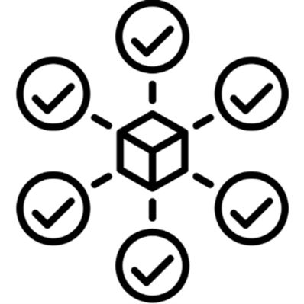
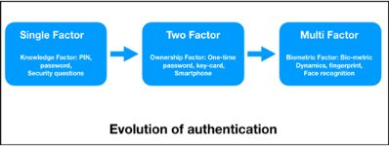
Authentication in Blockchain
Beginner:The process of proving a user’s identity on a blockchain network. It often uses cryptographic keys — a private key to sign and a public key to verify. This prevents unauthorized people from making transactions from your account.
Intermediate: Authentication in blockchain ensures that a participant is who they claim to be before interacting with the network. This is achieved through cryptographic methods such as public-private key pairs, digital signatures, or identity verification protocols. In permissionless systems, authentication is typically linked to wallet ownership, while permissioned systems may require KYC.
Video URL: https://www.youtube.com/watch?v=AYXa_OFBk2U

Slide 4
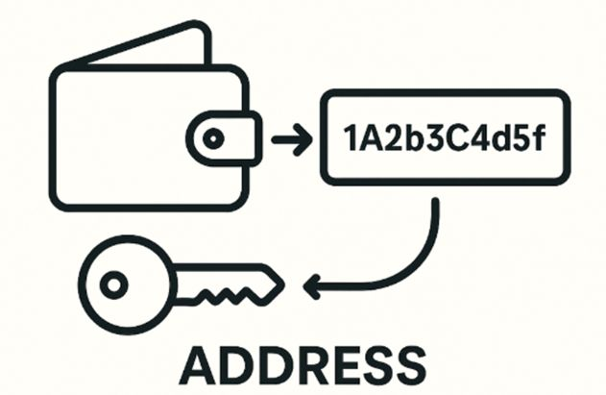
Address (Unique ID)
BeginnerA unique identifier where cryptocurrency can be sent or received. It is generated from a public key and usually appears as a long string of characters. Every user’s address is unique, similar to an account number in banking.:
Intermediate: A blockchain address is a string derived from the user’s public key, serving as a unique identifier for sending and receiving crypto. Addresses are usually generated using cryptographic hashing (e.g., Bitcoin uses SHA-256 and RIPEMD-160). They do not reveal the user’s identity but are linked to all transactions made from that address.
Video URL: https://www.youtube.com/watch?v=MoQa_zdmoKs

Slide 5
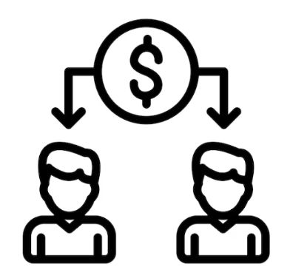
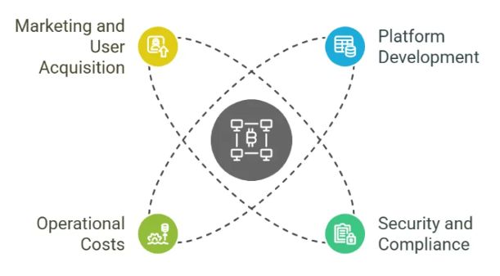
Acquisition Cost
Beginner:The original price or value when you obtained a cryptocurrency. It can be the purchase price in fiat currency or the market value at the time. Used for tracking profits, losses, and tax calculations.
Intermediate: In blockchain and crypto investing, acquisition cost refers to the total expense of obtaining an asset. This includes the purchase price, transaction or gas fees, and any other costs associated with acquisition. It’s important for calculating profit, loss, and tax liabilities when the asset is sold or swapped.
Video URL: https://www.youtube.com/watch?v=oNHprVzl3uo

Slide 6

Aeternity Blockchain
Beginner:A blockchain platform focused on scalability and real-world data integration. It uses state channels for off-chain transactions to improve speed and lower costs. It also has built-in oracles to bring external information into smart contracts.
Intermediate:Aeternity is a blockchain platform designed for high scalability, with a focus on smart contracts and decentralized oracles. It uses a hybrid consensus mechanism — Proof-of-Work (for key blocks) and Proof-of-Stake (for microblocks). Aeternity integrates state channels for off-chain transactions, reducing network congestion and costs.
Video URL: https://www.youtube.com/watch?v=fyC7d5pbX4s

Slide 7
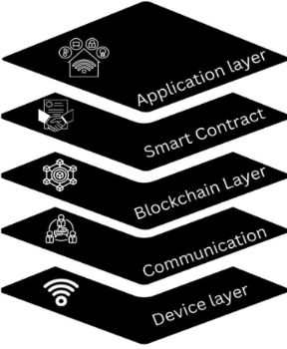
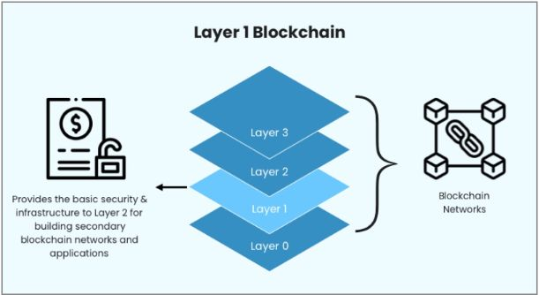
Application Layer
Beginner:The part of the blockchain ecosystem that users interact with directly. Includes user interfaces, decentralized apps (dApps), and APIs. This layer connects the user to the blockchain’s core functions
Intermediate: The application layer in blockchain architecture is where end-user interactions take place. It hosts decentralized applications (dApps), wallets, user interfaces, and smart contract logic. This layer communicates with the blockchain’s protocol layer to read/write data and execute transactions. Security, usability, and scalability in this layer are critical for adoption and user trust.
Video URL: https://www.youtube.com/watch?v=-7Auell6W78

Slide 8
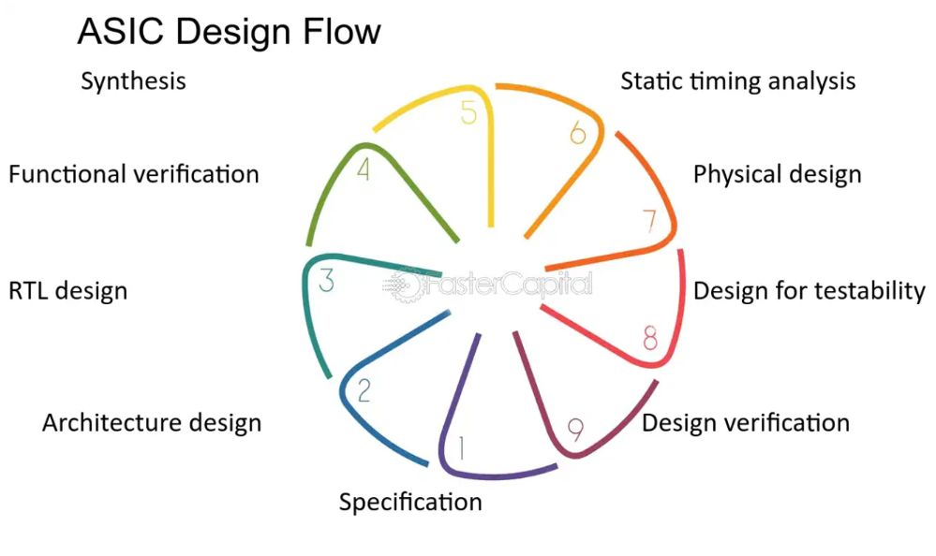
ASIC (Application-Specific Integrated Circuit)
Beginner:A hardware chip designed to perform a specific task extremely efficiently. In blockchain, ASICs are commonly used for mining cryptocurrency. They are faster and use less energy compared to general-purpose CPUs or GPUs.
Intermediate: An ASIC is specialized hardware built to perform a single computational task with maximum efficiency. In blockchain, ASICs are mainly used for Proof-of-Work mining to solve cryptographic puzzles. They offer much higher hash rates and energy efficiency compared to CPUs and GPUs. However, ASIC dominance can lead to centralization risks in mining networks.
Video URL: https://www.youtube.com/watch?v=GL3XNvzHKPM

Slide 9
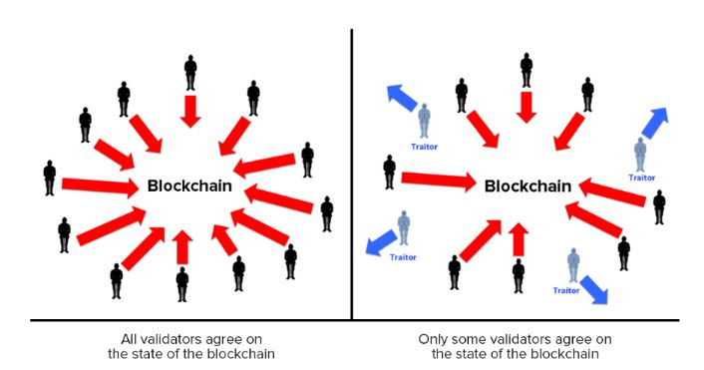
ABFT (Asynchronous Byzantine Fault Tolerance)
Beginner:A consensus approach that allows nodes to agree even if some are faulty or malicious. It does not require all nodes to communicate at the same time. Common in networks that need high fault tolerance without perfect synchronization.
Intermediate: ABFT is a consensus property allowing a network to reach agreement even if some participants act maliciously. “Asynchronous” means there’s no assumption about exact message timing, making it suitable for distributed environments. It can tolerate up to one-third of nodes being compromised without failing. ABFT algorithms, such as Hashgraph’s gossip protocol, are designed for speed, scalability, and fault resistance.
Video URL: https://www.youtube.com/watch?v=qv3uGJdDCpI

Slide 10
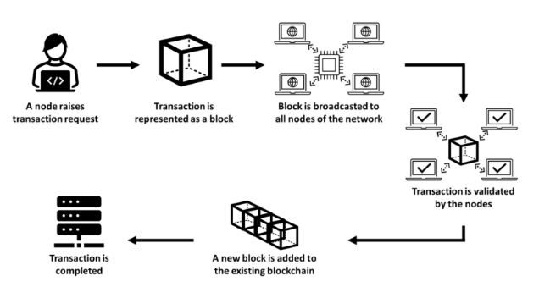
Audit (Blockchain or Smart Contract)
Beginner:A systematic review of blockchain code to ensure security and correctness. It checks for vulnerabilities, logical errors, and inefficiencies. Audits reduce the risk of hacks or system failures after launch.
Intermediate: A blockchain or smart contract audit is a thorough review of code and system configurations for vulnerabilities. Audits check for security issues like reentrancy attacks, integer overflows, and access control flaws. They can be performed manually by security experts or through automated static analysis tools. Regular audits are essential for DeFi platforms, as a single flaw can lead to major financial losses.
Video URL: https://www.youtube.com/watch?v=L8eG_TbxRVI

Slide 11
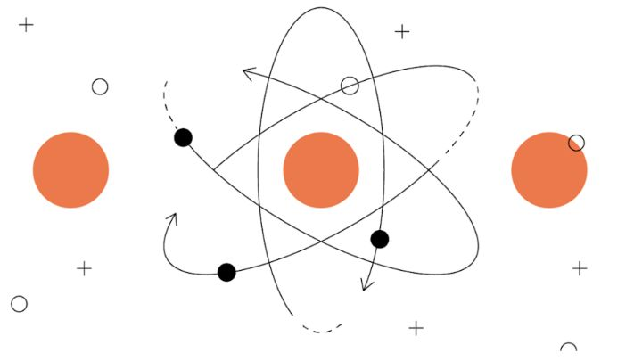
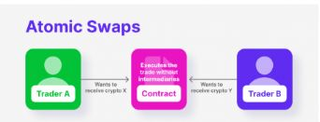
Atomic Swap
A method for exchanging cryptocurrencies directly between two parties. It uses smart contracts to ensure both sides fulfill the deal or nothing happens. Works across different blockchains without a central exchange.
Intermediate: An atomic swap enables the direct exchange of cryptocurrencies from different blockchains without a trusted third party. It uses smart contracts or HTLCs (Hashed Time-Locked Contracts) to ensure both trades happen simultaneously or not at all. This eliminates counterparty risk while maintaining decentralization. Atomic swaps can be on-chain (via blockchain transactions) or off-chain (via Layer-2 channels).
Video URL: https://www.youtube.com/watch?v=MoQa_zdmoKs

Slide 12
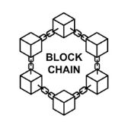
Blockchain
Beginner:A digital ledger where data is stored in blocks that are linked in sequence. Once added, blocks cannot be changed, ensuring data integrity. Blockchain is maintained by a distributed network of nodes.
Intermediate: A blockchain is a distributed ledger technology where data is stored in linked, immutable blocks. Each block contains transactions, a timestamp, and a cryptographic hash of the previous block. Consensus mechanisms like Proof-of-Work or Proof-of-Stake ensure all nodes agree on the ledger’s state. Blockchain enables decentralized, transparent, and tamper-resistant record-keeping for cryptocurrencies and beyond.

Slide 13

Block Ciphers
Beginner:A method of encrypting data in fixed-size chunks using a shared key. Ensures data confidentiality during storage or transmission. Common algorithms include AES (Advanced Encryption Standard).
Intermediate: A block cipher is a symmetric encryption algorithm that encrypts fixed-size blocks of data. It transforms plaintext into ciphertext using a shared secret key, often in modes like CBC or CTR. In blockchain, block ciphers secure wallet files, private keys, and communication channels. AES (Advanced Encryption Standard) is one of the most widely used block ciphers in the crypto ecosystem.

Slide 14
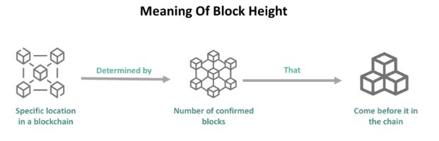
Block Height
Beginner:The number of blocks connected in the blockchain from the first (genesis) block. It shows the position of a block within the chain. Used to track blockchain growth and verify transactions.
Intermediate: Block height refers to the number of blocks in the blockchain from the genesis block to the current one. It is a measure of blockchain length and is incremented when a new block is added. Higher block heights indicate a longer chain and more cumulative work or stake. It’s also used to reference specific blocks for transaction verification or network events.

Slide 15
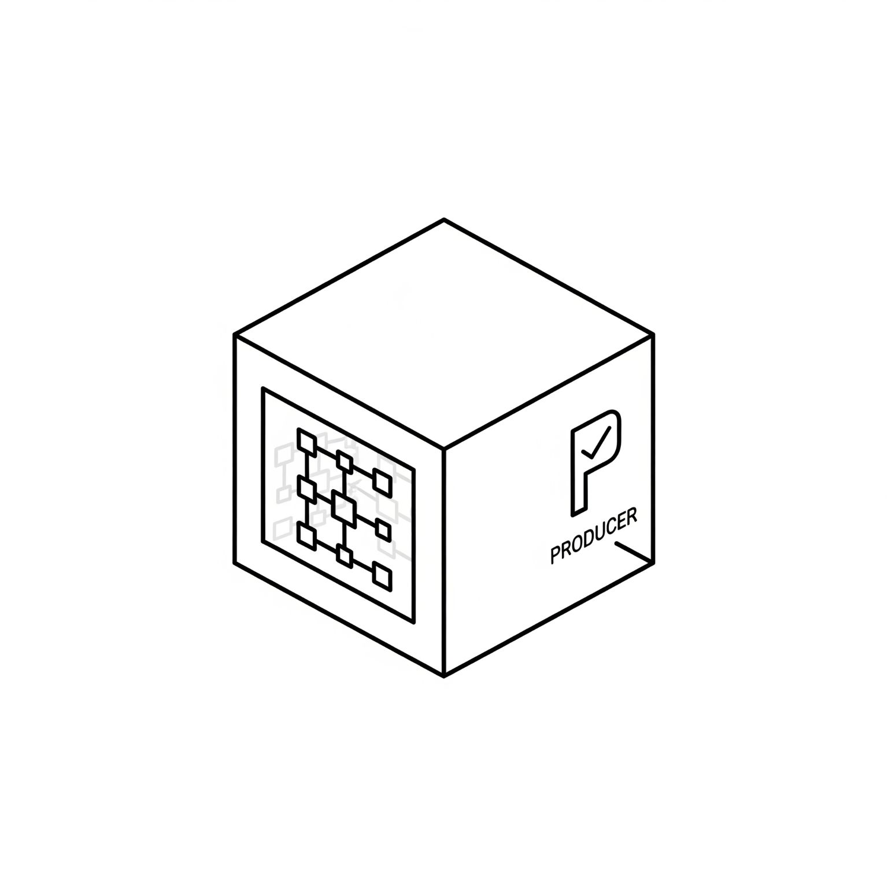
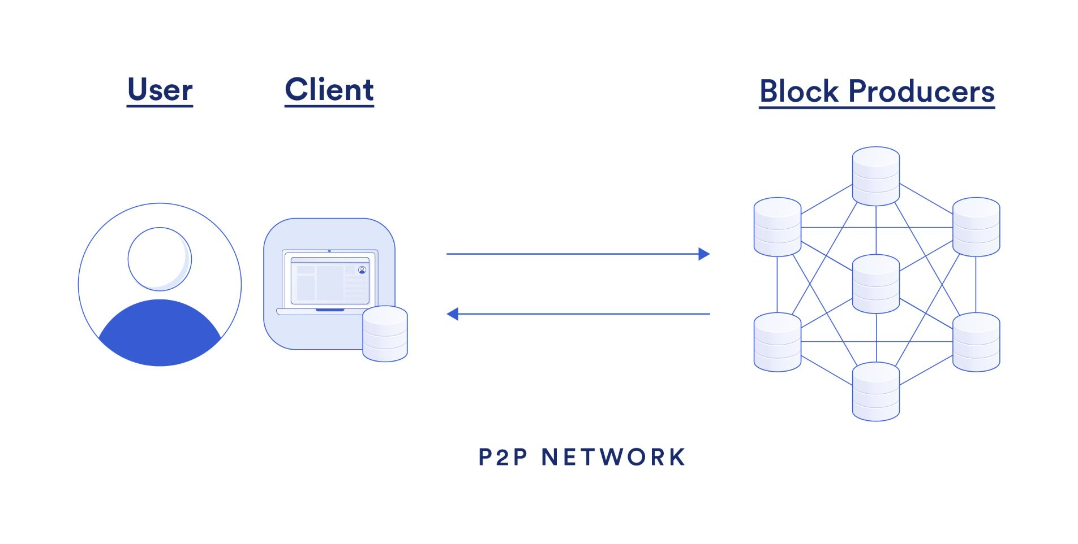
Block Producer
Beginner:A node or participant responsible for creating new blocks in some blockchains. In Delegated Proof of Stake (DPoS), they are chosen through voting. They collect transactions, validate them, and add them to the blockchain.
Intermediate: A block producer is a node in certain blockchain networks—especially those using Proof-of-Stake (PoS), Delegated PoS (DPoS), or Proof-of-Authority (PoA)—tasked with collecting pending transactions, validating them, bundling them into new blocks, and adding these blocks to the chain. Unlike miners in Proof-of-Work systems, block producers are selected through stakeholder votes or authority-based mechanisms, aiming for efficiency and sustainability. They play key roles in maintaining the network’s integrity, processing speed, and governance, often rewarded for their service. Examples include EOS and Tron, which rely on a fixed number of rotating block producers to uphold decentralization while enabling high throughput. Da

Slide 16
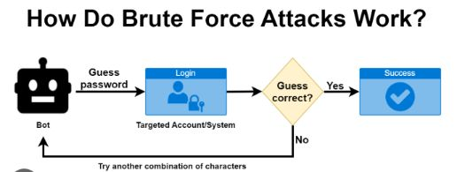
Brute Force Attack
Beginner:A hacking method that tries every possible password or key combination. Effective against weak security, but slow against strong cryptography. Prevention includes using long, complex keys and rate-limiting attempts.
Intermediate: A brute force attack systematically tries all possible keys or passwords until it finds the correct one. In blockchain, this method can target encrypted wallet files or private keys, although their high entropy makes them extremely resistant. Properly implemented cryptosystems, long keys, and mechanisms such as rate limiting or multi-factor authentication can mitigate these attacks. While brute force works against weak credentials, wallet security best practices make it largely impractical in blockchain contexts.

Slide 17
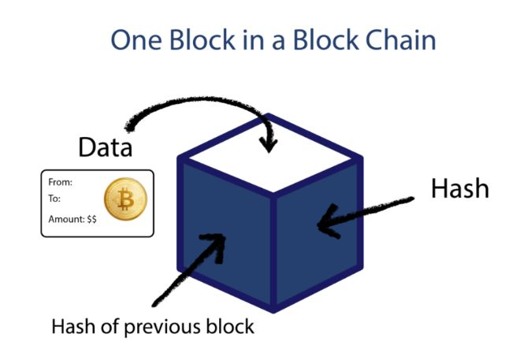
Blocks
Beginner:Data structures containing transaction records, timestamps, and a link to the previous block. Blocks are chained together to form the blockchain. They are validated and added by miners or validators.
Intermediate: Blocks are fundamental data structures in a blockchain, composed of a header, a list of validated transactions, and a hash linking to the previous block. The header typically includes metadata like the timestamp, version, nonce, and Merkle root—enabling efficient verification and immutability. As each new block is appended, it forms a tamper-evident ledger, with altering any transaction requiring redoing every subsequent block.

Slide 18

Bitcoin
Beginner:The first decentralized cryptocurrency, launched in 2009. It uses Proof of Work to validate transactions and secure the network. Its supply is limited to 21 million coins.
Intermediate: Bitcoin is the first decentralized cryptocurrency, introduced in 2009 by Satoshi Nakamoto. It uses Proof-of-Work (PoW) consensus, where miners validate transactions and secure the network. Each transaction is permanently stored on a public blockchain, ensuring transparency and immutability. Bitcoin also acts as a store of value and medium of exchange, often referred to as “digital gold.”

Slide 19
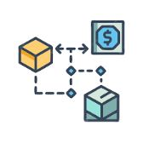
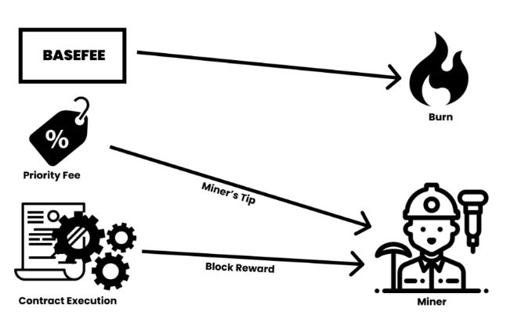
Base Fee
Beginner:A minimum fee for transactions on Ethereum introduced by EIP-1559. It is burned (removed from supply) and adjusts with network demand. Separate from optional “priority fees” to speed up transactions.
Intermediate: The base fee is a mandatory transaction fee introduced by Ethereum’s EIP-1559 upgrade. It is algorithmically adjusted depending on network congestion and is burned instead of going to miners or validators. This mechanism improves fee predictability and reduces inflationary pressure on ETH supply. Users can add a “tip” for validators to prioritize their transactions.

Slide 20

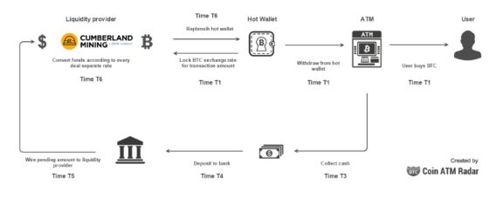
Bitcoin ATM
Beginner:A physical kiosk that allows buying or selling Bitcoin for cash. Often requires ID verification depending on regulations. Connected to crypto exchanges to process transactions instantly.
Intermediate: A Bitcoin ATM is a kiosk that allows users to buy or sell Bitcoin using cash or debit cards. These machines connect directly to a cryptocurrency exchange or wallet infrastructure. While convenient, they often charge higher fees compared to online exchanges. KYC (identity verification) may be required depending on regulations.

Slide 21
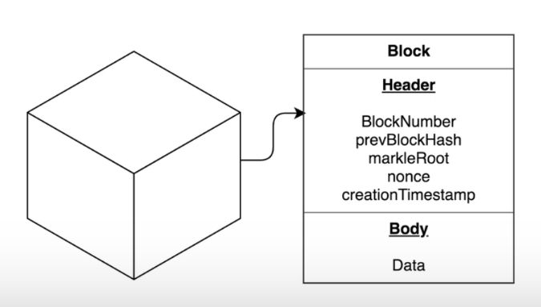
Block Size
Beginner:The maximum amount of data a block can contain. Affects how many transactions fit in a single block. Larger blocks can improve throughput but may reduce decentralization.
Intermediate: Block size refers to the maximum amount of data a block can contain. In Bitcoin, the original block size was capped at 1 MB, limiting the number of transactions processed per block. Disputes over block size scalability led to forks like Bitcoin Cash, which adopted larger block sizes. It directly affects throughput, fees, and scalability.

Slide 22
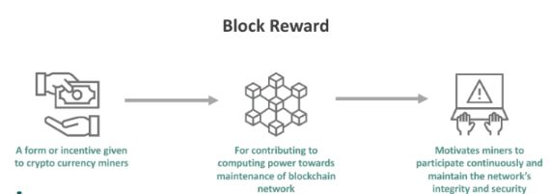
Block Reward
Beginner:The new coins and transaction fees given to a miner or validator for creating a block. In Bitcoin, the reward halves roughly every four years (halving). Encourages participants to secure the network.
Intermediate: The block reward is the incentive miners receive for successfully validating and adding a new block. It consists of newly minted coins plus transaction fees. Block rewards decrease over time through events like Bitcoin halving, making supply scarcer. This mechanism aligns network security with monetary issuance.

Slide 23
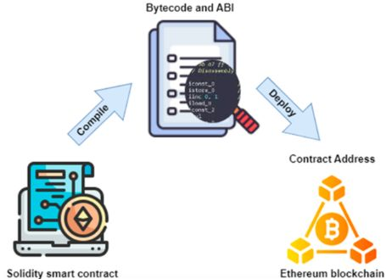
Bytecode
Beginner:Low-level instructions executed by the Ethereum Virtual Machine (EVM). Generated from higher-level languages like Solidity. Enables smart contracts to run consistently across all nodes.
Intermediate: In blockchain (Ethereum in particular), bytecode is the low-level, machine-readable code executed by the Ethereum Virtual Machine (EVM). Smart contracts written in Solidity are compiled into bytecode before deployment. This ensures consistent execution across all nodes. Bytecode enables deterministic, trustless contract behavior across the network.

Slide 24
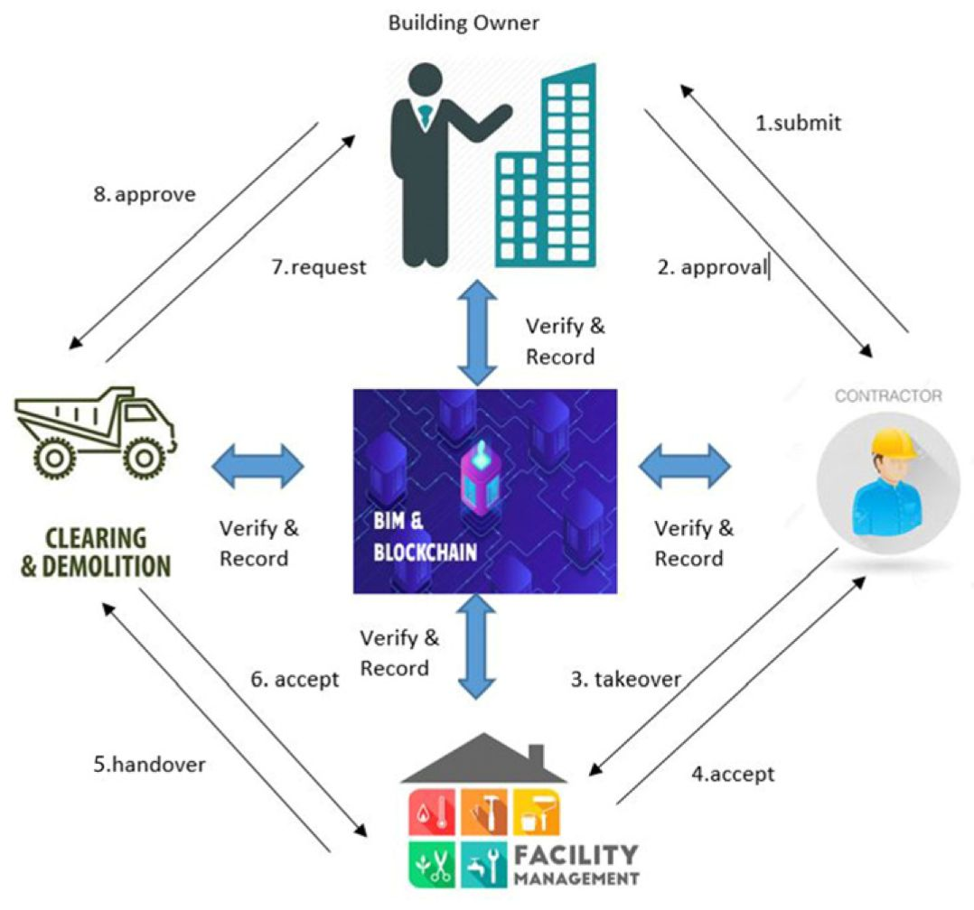
Byzantine Fault Tolerance
Beginner:The ability of a system to reach consensus even if some participants act dishonestly. Important for decentralized networks to function correctly. Forms the basis of several blockchain consensus algorithms.
Intermediate: BFT is the ability of a distributed system to continue operating correctly even if some participants act maliciously or fail. In blockchain, consensus algorithms like PBFT (Practical BFT) ensure agreement despite “Byzantine” actors. It guarantees trustless coordination without requiring central control. This is fundamental for security in decentralized systems.

Slide 25
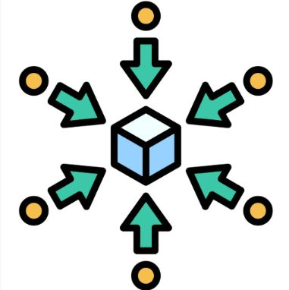
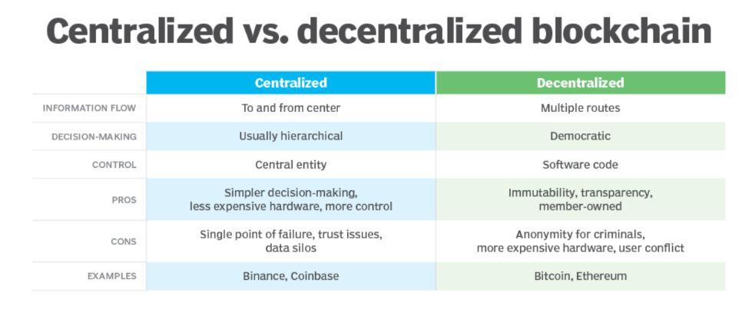
Centralized
Beginner:A system controlled by a single authority or organization. Decisions and data storage happen in one place. More efficient but has a single point of failure.
Intermediate: A centralized system is one where decision-making, control, and data storage are governed by a single authority or entity. Traditional banks and companies are centralized, as they control access, permissions, and operations. In contrast, blockchain decentralizes control, reducing single points of failure and censorship.

Slide 26
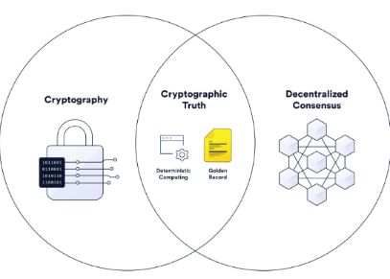
Cryptoanalysis
Beginner:The study of methods for breaking or bypassing encryption. Used to find weaknesses in cryptographic algorithms. Helps improve security systems in blockchain.
Intermediate: Cryptoanalysis is the study of analyzing and breaking cryptographic algorithms to find weaknesses. In blockchain, it focuses on testing the robustness of hashing, encryption, and digital signatures. Strong algorithms like SHA-256 are designed to resist known cryptoanalytic methods. Ongoing cryptoanalysis ensures long-term system security.

Slide 27
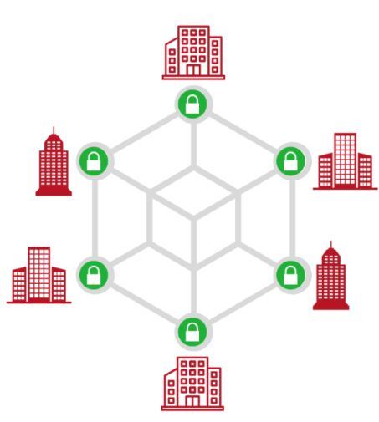
Consortium Blockchains
Beginner:A semi-private blockchain managed by multiple trusted organizations. Offers more control than public chains but more openness than private ones. Used in industries like finance and supply chain.
Intermediate: A consortium blockchain is a semi-decentralized blockchain governed by a group of organizations rather than one single entity. It is permissioned, meaning only approved participants can validate transactions. These blockchains are popular in enterprise use cases like supply chains and banking, balancing transparency with control.

Slide 28
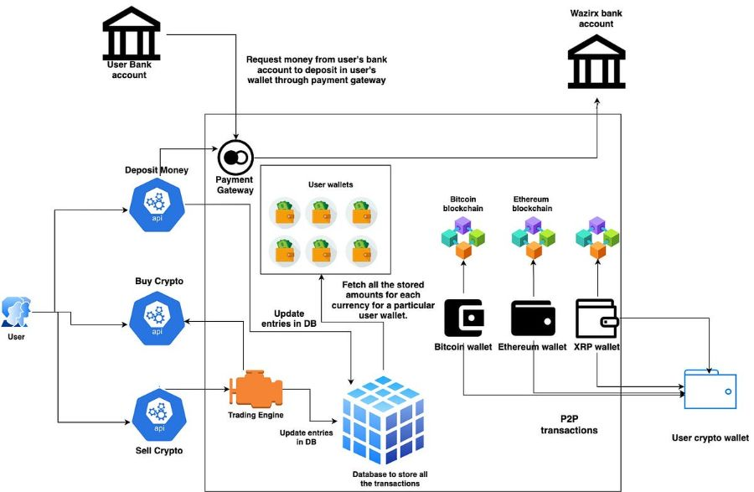
Centralized Exchange (CEX)
Beginner:A platform where users trade crypto through an intermediary. The exchange holds custody of user funds. Examples include Binance, Coinbase, and Kraken.
Intermediate: A centralized exchange (CEX) is a crypto trading platform run by a company that manages custody of user funds. Users trade through the exchange’s internal ledger instead of directly on-chain. CEXs provide liquidity, fiat on-ramps, and advanced trading tools but require trust in the operator. Security breaches and regulations are major concerns.

Slide 29

Cipher
Beginner:An algorithm for encrypting and decrypting data. Protects transaction details and communication on a blockchain. Examples include AES, DES, and ChaCha20.
Intermediate: A cipher is an algorithm used for encrypting and decrypting data, ensuring confidentiality in blockchain communication. Blockchains often use block ciphers like AES to secure wallets and transactions. The strength of a cipher depends on its resistance to attacks such as brute force and cryptanalysis. Ciphers are a foundation of blockchain security.

Slide 30
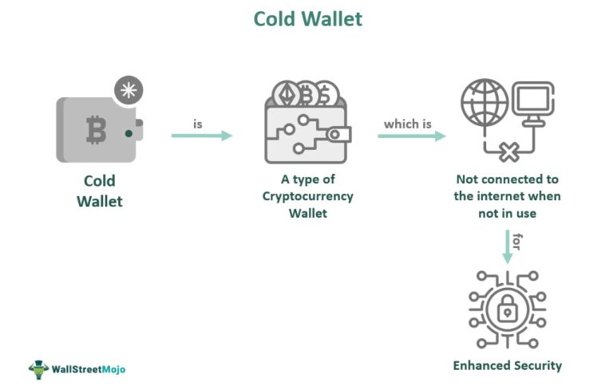
Cold Wallet
Beginner:A cold wallet is a way to keep your cryptocurrency safe without being connected to the internet. It’s like storing your gold in a safe instead of keeping it in your pocket. Because it’s offline, hackers can’t easily steal from it.
Intermediate: A cold wallet is an offline cryptocurrency storage method, often in the form of hardware devices or paper wallets. Since it is disconnected from the internet, it protects against hacking and malware. Cold wallets are best for long-term holding of large funds, though they are less convenient for frequent transactions.

Slide 31
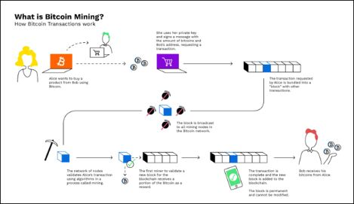
Cloud Mining
Beginner:Cloud mining is when you rent someone else’s computers to mine cryptocurrency for you. You don’t have to buy or run any machines yourself. You pay the company, and they give you a share of the coins they mine.
Intermediate: Cloud mining allows users to rent mining hardware or hashing power from remote data centers. Instead of maintaining expensive rigs, users pay providers for a share of mining rewards. While it lowers entry barriers, it is often criticized for low profitability and potential scams. Legitimate platforms offer transparency in mining operations.

Slide 32
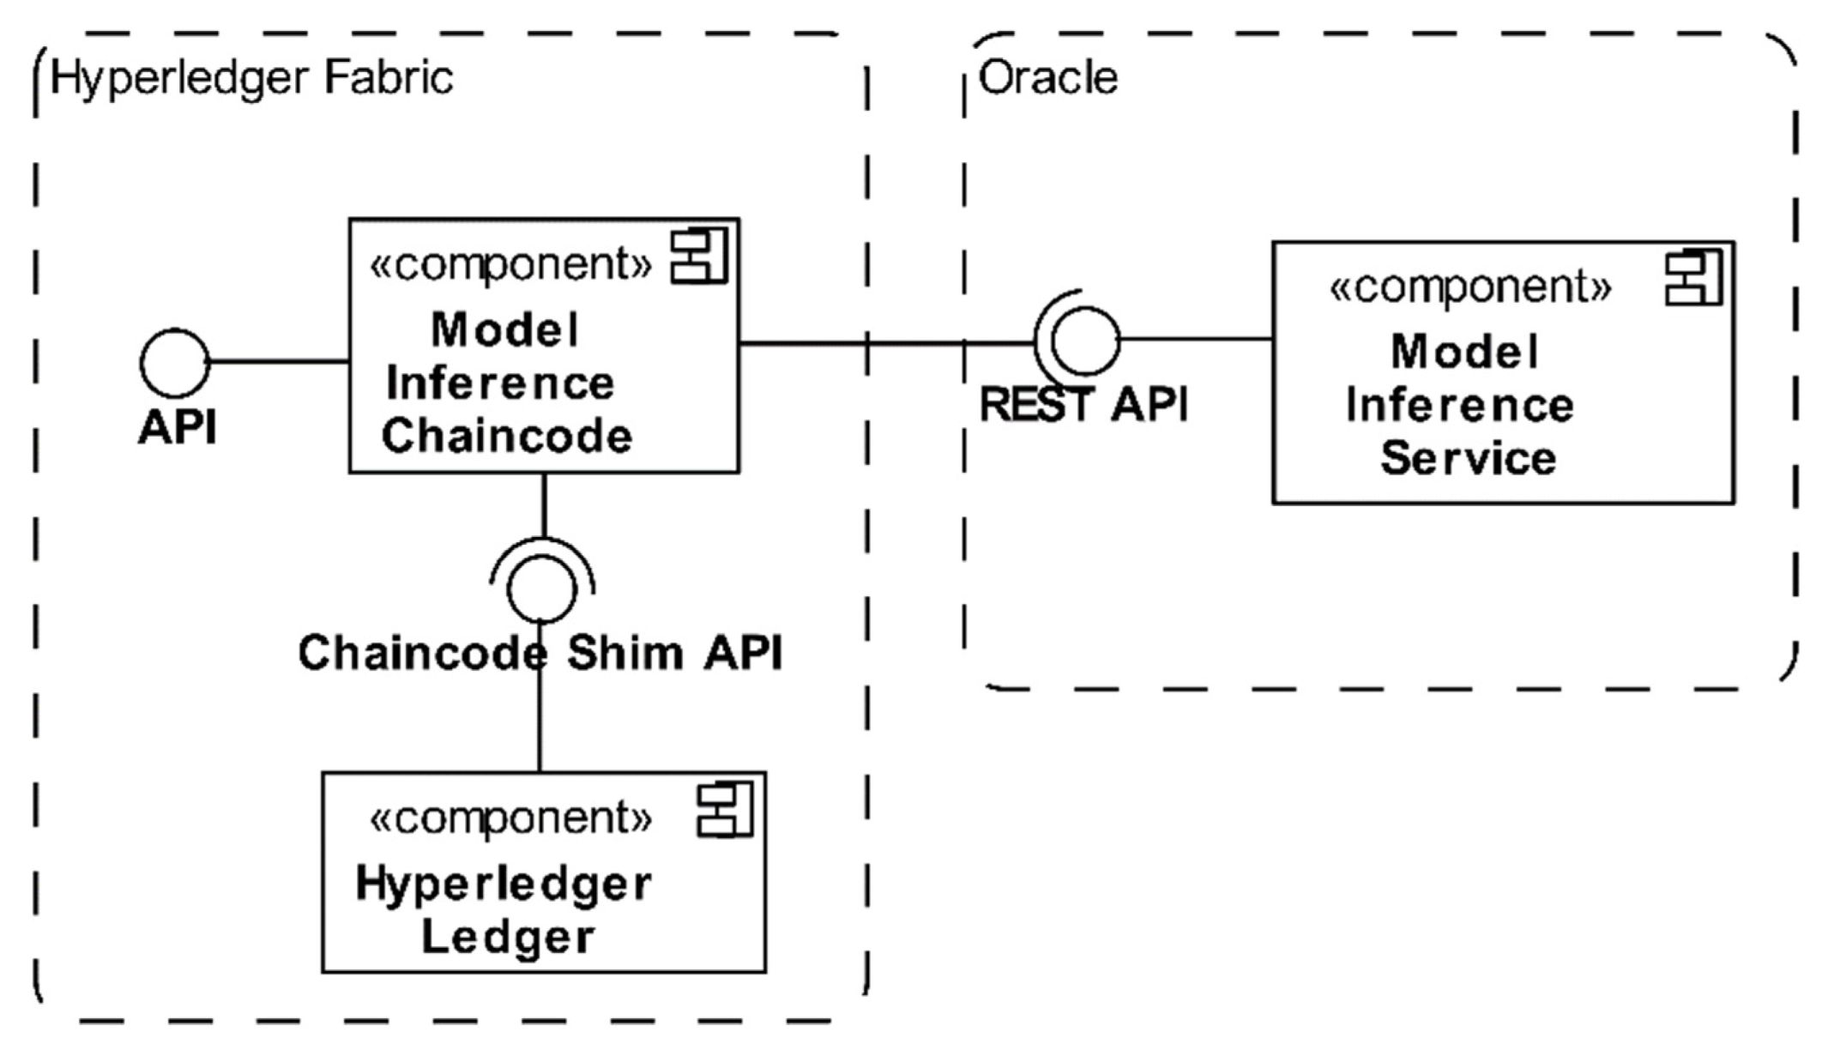
Chaincode
Beginner:Cloud mining is when you rent someone else’s computers to mine cryptocurrency for you. You don’t have to buy or run any machines yourself. You pay the company, and they give you a share of the coins they mine.
Intermediate: Chaincode is the term for smart contracts in Hyperledger Fabric, a permissioned blockchain. It defines the business logic that runs on peers, enabling transaction validation and state updates. Unlike Ethereum, Hyperledger supports multiple programming languages for chaincode, making it enterprise-friendly. It enforces rules in a secure, distributed manner.

Slide 33

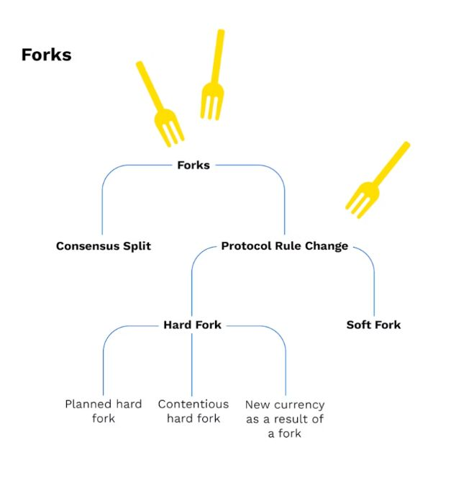
Cross Fork
Beginner:A cross fork is when a blockchain splits into two different versions. This happens when people can’t agree on the rules. Each version continues on its own path with its own blocks and transactions.
Intermediate: A cross fork occurs when two different blockchain networks share part of the same transaction history but then diverge into separate chains. This may happen due to disagreements over protocol changes or upgrades. It can lead to token duplication, where users hold equivalent coins on both chains. Proper replay protection is crucial in such cases.

Slide 34

Central Ledger
Beginner:A central ledger is a single record book of transactions kept by one trusted organization. Only that organization can add or change the records. It’s like one big notebook at a bank where all account balances are written down.
Intermediate: A central ledger is a database maintained by a single trusted authority, such as a bank. Unlike distributed ledgers, all records are stored and updated in one location. While efficient, it introduces risks of single-point failure and censorship. Blockchains eliminate the need for central ledgers by using consensus-driven distributed systems.

Slide 35
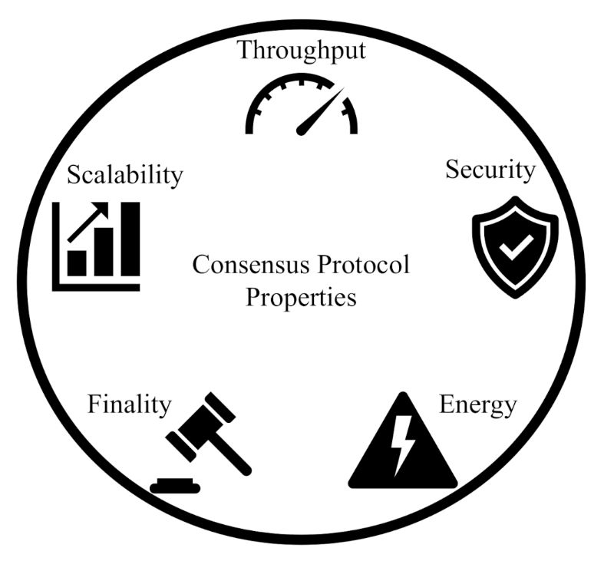
Consensus Algorithm
Beginner:A consensus algorithm is a way for computers in a blockchain network to agree on what transactions are valid. It makes sure everyone’s copy of the blockchain matches. It’s like a group agreeing on the rules before playing a game so no one cheats.
Intermediate: Consensus algorithms ensure agreement on the blockchain’s state across distributed nodes. Examples include Proof-of-Work, Proof-of-Stake, and PBFT. They prevent double-spending, resist malicious actors, and maintain trust in a trustless system. The choice of consensus impacts scalability, energy use, and decentralization.

Slide 36

Cryptocurrency
Beginner:Cryptocurrency is digital money that exists only online. It uses special math to keep it safe and works without banks. You can send it directly to someone anywhere in the world.
Intermediate: A cryptocurrency is a digital asset secured by cryptography and powered by blockchain networks. It functions as money, store of value, or utility token depending on its design. Unlike fiat, cryptocurrencies are decentralized and borderless, enabling peer-to-peer transfers without banks. Examples include Bitcoin, Ethereum, and stablecoins.

Slide 37
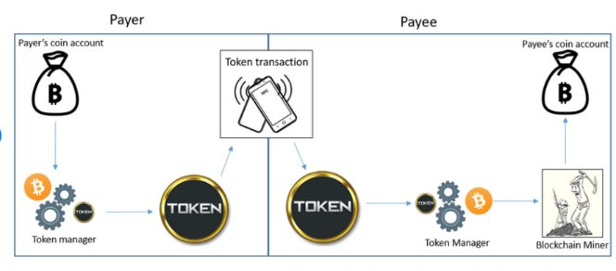
Crypto wallet
Beginner:A crypto wallet is a tool for keeping your cryptocurrency safe. It stores the “keys” you need to send or receive coins. It can be an app, a device, or even a piece of paper.
Intermediate: A crypto wallet is a tool that stores private keys, enabling users to send, receive, and manage cryptocurrencies. Wallets can be hot (online, convenient) or cold (offline, secure). They don’t store coins directly but provide access to blockchain balances. Security of private keys is critical to asset protection.

Slide 38
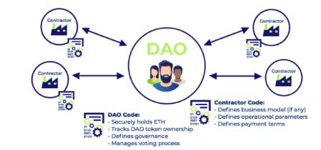
DAO (Decentralized Autonomous Organization)
Beginner:A DAO is like a group or company that runs itself using computer code. The rules are built into the program, and members vote on changes. No single person is in charge — decisions are made together.
Intermediate: A DAO is a blockchain-based organization governed by smart contracts and community voting instead of centralized leadership. It enables token holders to propose and vote on decisions like funding, upgrades, or policies. DAOs eliminate the need for intermediaries by enforcing transparent, automated governance. They’re used in DeFi, gaming, and venture capital.

Slide 39

dApp (Decentralized Application)
Beginner:A dApp is an application that runs on a blockchain instead of a single company’s server. It uses smart contracts to work automatically and is controlled by its users, not one authority. Example: A crypto wallet app or a blockchain-based game where all data is stored on the blockchain.
Intermediate: A dApp is an application built on blockchain where the backend runs on decentralized networks instead of centralized servers. It leverages smart contracts to provide transparency, security, and censorship resistance. Users interact directly with blockchain without intermediaries, often via wallets like MetaMask. Popular dApps include Uniswap and OpenSea.

Slide 40
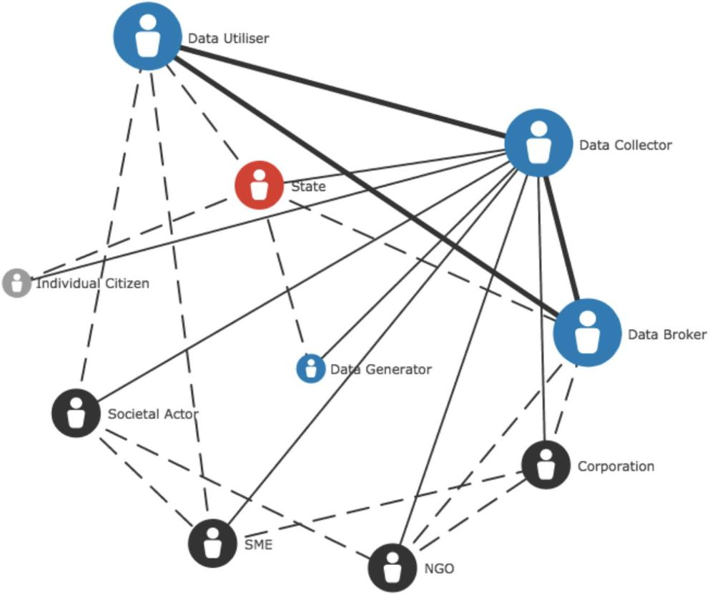
Decentralization
Beginner:Decentralization means control and decision-making are spread across many participants instead of one central authority. In blockchain, it ensures no single person or organization can change data or rules on their own.
Intermediate: Decentralization in blockchain means no single entity controls the system, as data is spread across multiple nodes. This improves transparency, security, and resilience against attacks or censorship. It contrasts with traditional centralized systems where a single authority has control. Decentralization is the foundation of trustless networks like Bitcoin and Ethereum.

Slide 41
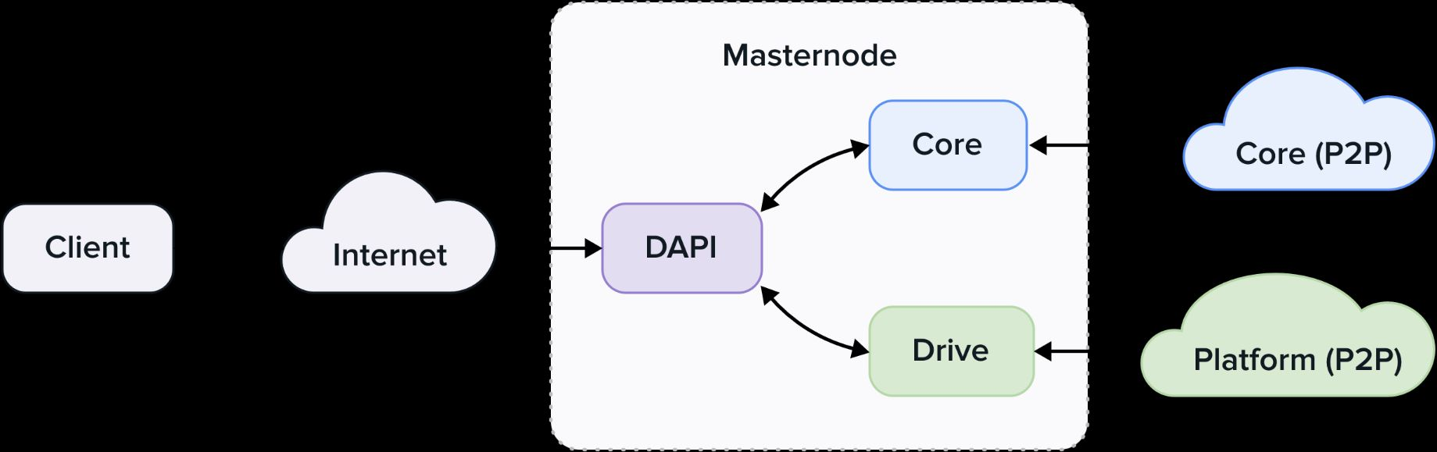
Decentralized API (dAPI)
Beginner:A decentralized API is a way for apps to get information without using one company’s server. Instead, the data comes from many sources. This makes it harder to shut down or control.
Intermediate: A dAPI is an API built on blockchain that provides decentralized access to services like data feeds or payments. Unlike centralized APIs, it uses multiple oracles to avoid single points of failure. dAPIs enable smart contracts to access external real-world data securely. They’re critical in powering DeFi and Web3 apps.

Slide 42
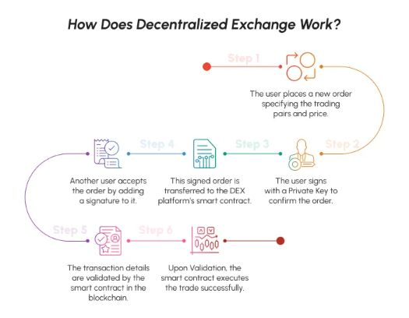
Decentralized Exchange (DEX)
Beginner:A DEX is a platform where people trade cryptocurrencies directly without a central authority. It uses smart contracts to match and settle trades on the blockchain. Example: Uniswap lets users swap tokens without a middleman.
Intermediate: A DEX allows users to trade cryptocurrencies directly without intermediaries or custody of funds. Trades are executed through smart contracts on blockchain, ensuring transparency and security. DEXs like Uniswap and PancakeSwap use liquidity pools instead of traditional order books. This removes reliance on centralized exchanges (CEXs).

Slide 43
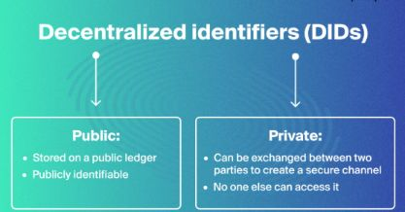
Decentralized Identifier (DID)
Beginner:A DID is a unique ID stored on a blockchain that users control themselves. It helps prove identity online without relying on companies. Example: A blockchain-based digital passport.
Intermediate: A DID is a self-owned digital identity stored on blockchain, not controlled by centralized entities. It enables users to prove identity or credentials without revealing unnecessary personal data. DIDs empower privacy, portability, and verifiable identity management across Web3. They are central to self-sovereign identity systems.

Slide 44
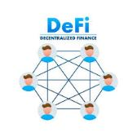
DeFi (Decentralized Finance)
Beginner:DeFi is financial services like lending, borrowing, and trading built on blockchain. It removes banks and middlemen by using smart contracts. Example: Earning interest on crypto through Aave.
Intermediate: DeFi refers to blockchain-based financial services such as lending, trading, and insurance without banks. It uses smart contracts to automate agreements, eliminating intermediaries. DeFi platforms offer transparency, accessibility, and yield opportunities but face risks like hacks or volatility. Popular DeFi protocols include Aave and Compound.

Slide 45
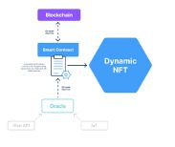
dNFT (Dynamic Non-Fungible Token)
Beginner:A dNFT is an NFT whose data can change over time based on events or inputs. It still stays unique but updates automatically through smart contracts. Example: A sports NFT that updates player stats after each game.
Intermediate: A dNFT is a special NFT that can change its metadata or attributes based on conditions or real-world events. Unlike static NFTs, they update automatically via smart contracts or oracles. They are used in gaming, identity, and asset tracking. dNFTs expand NFT utility by allowing evolution over time.

Slide 46
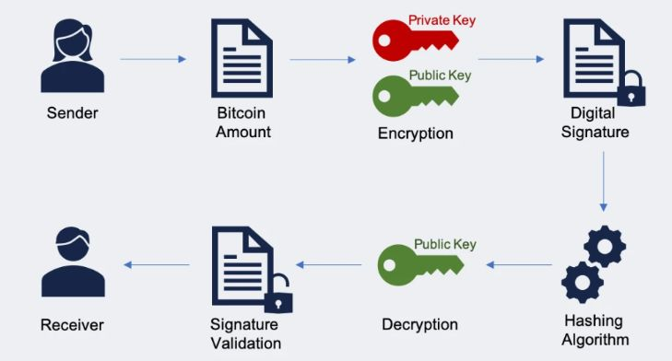
Digital Signature
Beginner:A digital signature is a code that proves a transaction or message came from you. It’s created using your private key and can be verified with your public key. Example: Signing a blockchain transaction to send crypto.
Intermediate: A digital signature is a cryptographic method to prove ownership and authenticity of data or transactions. In blockchain, private keys generate signatures that can be verified with public keys. They secure transactions against tampering or forgery. Digital signatures are the backbone of trust in peer-to-peer transfers.

Slide 47
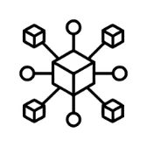
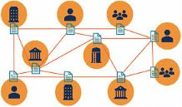
Distributed Ledger
Beginner:A distributed ledger is a shared database stored across many computers. Every participant has the same copy, so it’s hard to tamper with. Example: Bitcoin’s blockchain is a type of distributed ledger.
Intermediate: A distributed ledger is a database spread across multiple nodes in a network, where each node maintains a synchronized copy. Blockchain is one type of distributed ledger that uses cryptography and consensus to validate updates. It removes the need for a central authority to maintain records. This ensures transparency and resilience.

Slide 48
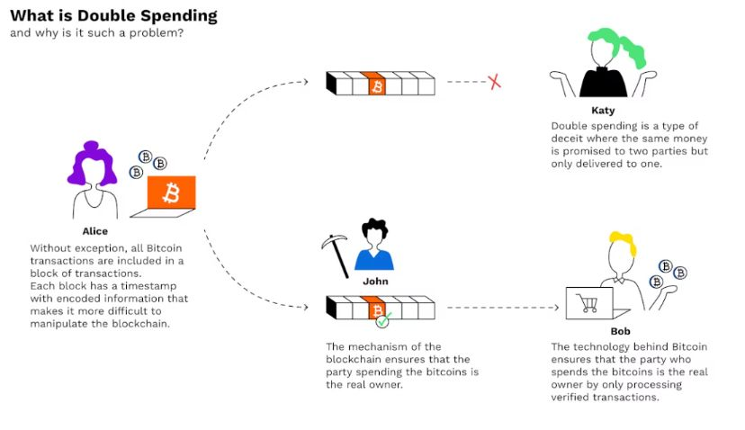
Double Spending
Beginner:Double spending is when someone tries to use the same digital coin twice. Blockchain prevents this by confirming transactions in a shared ledger. Example: Bitcoin’s network rejects duplicate transactions.
Intermediate: Double spending happens when someone tries to use the same cryptocurrency twice. In blockchain, this is prevented through consensus mechanisms like Proof of Work (PoW), which validate transactions and record them in blocks. Without protection, digital money could be duplicated easily. Bitcoin solved this by making the ledger immutable.

Slide 49

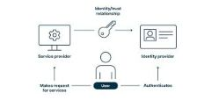
Digital Identity
Beginner:A digital identity is an online version of who you are, stored securely. Blockchain can give you control over your own identity data. Example: Using your blockchain ID to log into websites without passwords.
Intermediate: Digital identity in blockchain is a secure representation of an individual or entity’s credentials on a decentralized ledger. It allows verification without relying on centralized authorities. Users can control their data and decide what to share. It underpins self-sovereign identity and decentralized apps.

Slide 50
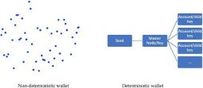
Deterministic Wallet
Beginner:A deterministic wallet creates all your crypto addresses from a single master seed. This means you can back up and recover them with just one phrase. Example: A 12-word recovery phrase in MetaMask.
Intermediate: A deterministic wallet generates all private/public keys from a single seed phrase. This allows easy recovery of funds with just the seed, avoiding the need to back up multiple keys. Hierarchical Deterministic (HD) wallets create organized paths for managing multiple addresses. They’re standard in modern crypto wallets like MetaMask.

Slide 51
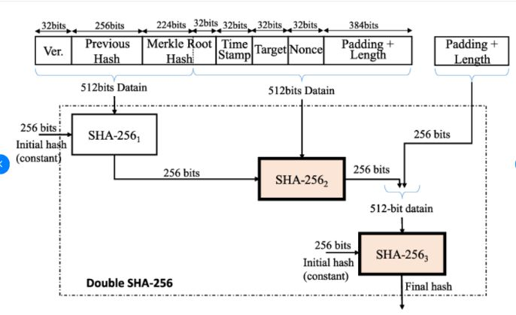
Double Hashing
Beginner:Double hashing means applying a hash function twice to the same data. It’s used to make blockchain security stronger. Example: Bitcoin uses SHA-256 twice for each block header.
Intermediate: Double hashing applies a cryptographic hash function twice for added security. In Bitcoin, SHA-256 is applied two times to block headers to generate block IDs. This reduces vulnerabilities like length extension attacks. It makes blockchain records more tamper-resistant and reliable.

Slide 52

Dusting Attack
Beginner:A dusting attack sends tiny amounts of crypto to many wallets. Hackers track these transactions to try to link wallet addresses. Example: Sending a few satoshis to trace Bitcoin users’ identities.
Intermediate: A dusting attack involves sending tiny amounts of crypto (“dust”) to multiple addresses to break user privacy. Attackers analyze transaction patterns to link wallets and deanonymize users. It’s not financially harmful but can expose identities. Wallets often block or mark dust to prevent tracking.

Slide 53

Decryption
Beginner:Decryption is turning encrypted data back into readable form. It uses a key to unlock the original information. Example: Reading a message that was scrambled for security.
Intermediate: Decryption is the process of converting encrypted (coded) data back into its readable form using a key. In blockchain, it’s used to secure communication and protect sensitive data. Only users with the right private key can decrypt information. This ensures confidentiality in transactions and messaging.

Slide 54

Eclipse Attack
Beginner:An eclipse attack traps a node in a fake network controlled by the attacker. This blocks the node from seeing the real blockchain. Example: Fooling a miner into mining on a fake chain.
Intermediate: An eclipse attack isolates a blockchain node by surrounding it with malicious peers. This prevents the node from seeing the true network state and allows manipulation, such as delaying transactions. It’s a type of network-layer attack and is mitigated by peer diversity and connection rules.

Slide 55

Encryption
Beginner:Encryption scrambles data so only someone with the right key can read it. It keeps blockchain transactions and communications secure. Example: Protecting your private key with encryption.
Intermediate: Encryption converts plain information into unreadable ciphertext using cryptographic algorithms. In blockchain, encryption secures data, wallets, and communications. Public-key cryptography ensures that only authorized parties can access or send secure messages. It is essential for protecting private keys and transactions.

Slide 56


ERC-223
Beginner:ERC-223 is a token standard on Ethereum that prevents accidental token loss. It allows safe transfers to both wallets and smart contracts. Example: Tokens that can’t be lost by sending to the wrong address type.
Intermediate: ERC-223 is a proposed Ethereum token standard that fixes ERC-20’s issue of lost tokens when accidentally sent to smart contracts. It allows tokens to be recovered or rejected instead of being lost forever. While not as popular as ERC-20 or ERC-721, it improves usability and safety for Ethereum tokens.

Slide 57

ERC-20
Beginner:ERC-20 is the most common token standard on Ethereum. It defines rules like transfers, balances, and approvals. Example: USDT and UNI tokens follow ERC-20 rules.
Intermediate: ERC-20 is the most widely used Ethereum token standard for fungible tokens. It defines rules like transfer, balance check, and approval that all tokens must follow. This standard made ICOs and DeFi possible by ensuring compatibility across wallets and exchanges. Most Ethereum-based tokens follow ERC-20.

Slide 58

ERC-721
Beginner:ERC-721 is the standard for unique, non-fungible tokens on Ethereum. It’s used for NFTs like art, collectibles, and game items. Example: Bored Ape Yacht Club NFTs.
Intermediate: ERC-721 is the Ethereum token standard for non-fungible tokens (NFTs). Unlike ERC-20, every ERC-721 token is unique and cannot be replaced one-to-one. It powers NFT marketplaces like OpenSea and enables ownership of digital art, collectibles, and in-game assets. Its uniqueness makes it crucial for tokenizing real-world assets.

Slide 59

ERC-1155
Beginner:ERC-1155 lets you create both fungible and non-fungible tokens in one contract. It’s more efficient for games and collections. Example: A game with one contract for coins and items.
Intermediate: ERC-1155 is a multi-token standard that allows a single contract to manage both fungible and non-fungible tokens. It’s efficient because it reduces gas costs by handling multiple token types in one smart contract. It’s widely used in gaming, where items can be either identical or unique.

Slide 60

Escrow
Beginner:Escrow holds funds until certain conditions are met. On blockchain, smart contracts can act as escrow without middlemen. Example: Holding payment until goods are delivered.
Intermediate: In blockchain, an escrow is a smart contract that holds funds until specific conditions are met. It removes the need for a trusted third party, ensuring fair trades between buyers and sellers. Escrow is common in DeFi lending, NFT sales, and cross-border payments.

Slide 61

Ethereum
Beginner:Ethereum is a blockchain for building and running smart contracts and dApps. It supports its own cryptocurrency called Ether (ETH). Example: Apps like Uniswap and OpenSea run on Ethereum.
Intermediate: Ethereum is a blockchain platform that supports smart contracts and decentralized applications (dApps). It introduced programmability to blockchain, enabling DeFi, NFTs, and DAOs. Its native currency, Ether (ETH), is used for gas fees. Ethereum’s upcoming upgrades (like Proof-of-Stake and sharding) aim to improve scalability.

Slide 62

Etherscan
Beginner:Etherscan is a website to explore Ethereum transactions, blocks, and addresses. It lets anyone verify blockchain activity. Example: Checking if your ETH transfer was successful.
Intermediate: Etherscan is a blockchain explorer for Ethereum that allows users to view transactions, wallet balances, smart contracts, and token details. It provides transparency by showing real-time blockchain data. Developers and investors rely on Etherscan to verify activity on the Ethereum network.

Slide 63

EVM (Ethereum Virtual Machine)
Beginner:The EVM is the engine that runs Ethereum smart contracts. It processes code exactly as written on the blockchain. Example: Executing a DeFi loan agreement.
Intermediate: The EVM is the runtime environment for executing smart contracts on Ethereum. It ensures that code runs consistently across all Ethereum nodes. Developers write contracts in Solidity, which are compiled into bytecode executed by the EVM. It makes Ethereum a “world computer.”

Slide 64

Fiat Currency
Beginner:Fiat is traditional money issued by governments. It has value because people trust the issuer, not because it’s backed by assets. Example: USD, EUR, INR.
Intermediate: Fiat currency is government-issued money, like USD, EUR, or INR, that isn’t backed by a physical asset but by trust in the government. In blockchain, fiat is often the entry and exit point for crypto trading. Stablecoins bridge fiat with cryptocurrencies by pegging value to fiat currencies.

Slide 65

Full Node
Beginner:A full node stores a complete copy of the blockchain and verifies transactions. It helps keep the network decentralized and secure. Example: Running Bitcoin Core software on your computer.
Intermediate: A full node downloads and validates the entire blockchain, ensuring consensus rules are followed. Unlike light nodes, it doesn’t rely on third parties to verify transactions. Running a full node increases network security and decentralization but requires significant storage and bandwidth.

Slide 66
Faucet
Beginner:A faucet gives out small amounts of crypto for free. It’s often used for testing or to introduce new users. Example: Getting test ETH from a Ropsten faucet.
Intermediate: A crypto faucet is a website or app that gives users small amounts of cryptocurrency for free. Originally, faucets were used to spread awareness of Bitcoin. Today, faucets help users test wallets, explore testnets, or earn tiny rewards while learning.

Slide 67

Forging
Beginner:Forging is creating new blocks in a Proof-of-Stake blockchain. It’s similar to mining but uses staked coins instead of computing power. Example: NXT blockchain’s block creation method.
Intermediate: Forging is the process of creating new blocks in Proof-of-Stake (PoS) blockchains. Instead of mining with hardware, validators are chosen based on the amount of stake they hold. It’s more energy-efficient and faster than Proof-of-Work mining. Networks like Nxt and Cardano use forging/validation for block creation.

Slide 68

Fungibility
Beginner:Fungible items are interchangeable and equal in value. Most cryptocurrencies are fungible — one unit is the same as another. Example: 1 BTC always equals 1 BTC.
Intermediate: Fungibility means an asset is interchangeable with another of the same type. For example, 1 Bitcoin equals another Bitcoin. NFTs are non-fungible because each one is unique. Fungibility is essential in cryptocurrencies for seamless transactions.

Slide 69

Forking Bitcoin
Beginner:Forking means creating a new blockchain version from an existing one. In Bitcoin, this can be a soft fork or a hard fork. Example: Bitcoin Cash was created from a Bitcoin hard fork.
Intermediate: A fork is when the blockchain splits into two versions, often due to protocol changes. Soft forks keep compatibility, while hard forks create new blockchains like Bitcoin Cash. Forks allow upgrades but can also cause disagreements in the community.

Slide 70

Geth (Go-Ethereum)
Beginner:Geth is a software tool to run an Ethereum node. It lets you mine, send transactions, and deploy smart contracts. Example: Developers use Geth to test Ethereum apps locally.
Intermediate: Geth is a software client for running Ethereum nodes. It allows users to mine ETH, deploy contracts, and explore the blockchain. Developers use Geth to interact with Ethereum networks through command-line tools or APIs.

Slide 71

Genesis Block
Beginner:The genesis block is the very first block in a blockchain. It’s hardcoded and has special properties. Example: Bitcoin’s genesis block was mined by Satoshi Nakamoto in 2009.
Intermediate: The Genesis Block is the first block of any blockchain. For Bitcoin, it was created by Satoshi Nakamoto in 2009. It sets the foundation of the chain and often contains symbolic or special messages.

Slide 72

Governance
Beginner:Governance is how decisions are made in a blockchain project. It can be done by voting, code updates, or community proposals. Example: DAO members voting on a protocol change.
Intermediate: Governance refers to how decisions are made in blockchain networks. It can be on-chain (voting via tokens) or off-chain (developer/community discussions). Effective governance prevents forks and improves upgrades.

Slide 73

Game Theory
Beginner:Game theory studies how people make decisions in competitive situations. In blockchain, it helps design fair and secure systems. Example: Proof-of-Work incentives for miners.
Intermediate: Game theory studies how participants make strategic decisions. In blockchain, it ensures that miners, stakers, and validators behave honestly. Incentives and punishments maintain security and trustless collaboration.

Slide 74

Hyperledger Fabric
Beginner:Hyperledger Fabric is a permissioned blockchain for businesses. It supports private transactions and modular design. Example: Supply chain tracking between companies.
Intermediate: Hyperledger Fabric is an open-source permissioned blockchain developed by IBM and the Linux Foundation. It’s designed for enterprises with features like private transactions, modular consensus, and scalability.

Slide 75

Hash Function
Beginner:A hash function turns data into a fixed-size code. It’s one-way, meaning you can’t get the original data back. Example: Bitcoin uses SHA-256 to secure blocks.
Intermediate: A hash function converts any input into a fixed-size string (hash). In blockchain, it secures transactions and links blocks. Properties like immutability and collision resistance make it essential.

Slide 76

Hashcash
Beginner:Hashcash is a proof-of-work system to prevent spam and attacks. It’s used in Bitcoin mining to find valid block hashes. Example: Solving puzzles to mine BTC.
Intermediate: Hashcash is a proof-of-work system used in Bitcoin’s mining. It requires solving puzzles to add blocks, making spam or attacks costly. Originally designed for email spam prevention, it became Bitcoin’s foundation.

Slide 77

Halving
Halving reduces the reward for mining new blocks by 50%. It happens at fixed intervals to control supply. Example: Bitcoin’s last halving was in 2020.
Intermediate: Bitcoin halving happens every 210,000 blocks (~4 years). It cuts mining rewards in half, reducing new Bitcoin supply. This scarcity increases value over time and maintains inflation control.

Slide 78

Hashpower
Beginner:Hashpower is the computing power used for mining. More hashpower means more chances to mine a block. Example: A mining farm with thousands of GPUs.
Intermediate: Hashpower measures the computational strength miners use to solve Proof-of-Work puzzles. More hashpower increases mining chances and secures the network. It also indicates the overall health of a blockchain.

Slide 79

Hot Wallet
Beginner:A hot wallet is connected to the internet for quick access to crypto. It’s convenient but more vulnerable to hacks. Example: MetaMask or Trust Wallet.

Slide 80

Hardware Wallet
Beginner:A hardware wallet stores crypto keys offline for better security. It connects to your device only when needed. Example: Ledger Nano S or Trezor.
Intermediate: A hardware wallet is an offline device storing private keys securely. It protects against malware and phishing attacks. Popular examples: Ledger and Trezor.

Slide 81

ICO (Initial Coin Offering)
Beginner:An ICO is a fundraising method where tokens are sold to investors. It helps blockchain projects raise money quickly. Example: Ethereum’s 2014 ICO.

Slide 82

Immutable
Beginner:Immutable means data can’t be changed once it’s on the blockchain. This ensures trust and transparency. Example: A recorded Bitcoin transaction stays forever.

Slide 83

Interoperability
Beginner:Interoperability is when different blockchains can talk to each other. It allows asset and data transfer between networks. Example: Polkadot enables cross-chain communication.
Intermediate: Interoperability is the ability of different blockchains to communicate. It enables cross-chain swaps, shared data, and unified ecosystems. Projects like Polkadot and Cosmos lead this innovation.

Slide 84

Interledger Protocol (ILP)
Beginner:ILP moves payments across different ledgers and networks. It works like an internet for money. Example: Sending money from a bank to a blockchain wallet.
Intermediate: ILP is a protocol for transferring value between different blockchains and payment systems. It was developed by Ripple to support global interoperability. It ensures fast, cheap, and universal payments.

Slide 85

Intrinsic Tokens
Beginner:Intrinsic tokens are native to a blockchain. They’re essential for paying fees and securing the network. Example: ETH on Ethereum, BTC on Bitcoin.
Intermediate: Intrinsic tokens are native cryptocurrencies of a blockchain, like Bitcoin for Bitcoin or Ether for Ethereum. They pay transaction fees and incentivize validators/miners. Unlike utility tokens, they’re essential for blockchain operation.

Slide 86

KYC (Know Your Customer)
Beginner:KYC is the process of verifying a user’s identity. It’s required for regulatory compliance in exchanges. Example: Uploading your ID to open a crypto account.
Intermediate: KYC is a compliance process requiring identity verification before using crypto exchanges. It prevents fraud, money laundering, and ensures regulatory standards. Critics argue it reduces privacy.

Slide 87


Keccak-256
Beginner:Keccak-256 is a cryptographic hash function. Ethereum uses it to secure data and addresses. Example: Creating Ethereum wallet addresses.

Slide 88

Lightning Network
Beginner:Lightning Network is a second-layer payment system for Bitcoin. It allows faster and cheaper transactions. Example: Paying instantly for coffee using Bitcoin.

Slide 89

Liquidity Mining
Beginner:Liquidity mining rewards people for adding assets to DeFi pools. It helps platforms run smoothly with enough trading funds. Example: Earning tokens by providing ETH and USDT to Uniswap.

Slide 90

Layer-1
Beginner:Layer-1 is the base blockchain itself. It handles transactions, security, and consensus. Example: Bitcoin and Ethereum are Layer-1 networks.

Slide 91

Layer-2
Beginner:Layer-2 is a secondary network built on a Layer-1 blockchain. It improves speed and reduces fees. Example: Polygon on Ethereum.
Intermediate: Layer-2 solutions build on top of Layer-1 to improve speed and reduce costs. Examples include Lightning Network and Polygon. They offload computation while relying on Layer-1 for security.

Slide 92

Merkle Tree
Beginner:A Merkle tree organizes transaction data into a structure that’s easy to verify. It uses hashes to quickly confirm if data is unchanged. Example: Bitcoin uses Merkle trees to store transactions in blocks.
Intermediate: MetaMask is a crypto wallet and browser extension for Ethereum and EVM-compatible chains. It lets users interact with dApps, store tokens, and manage private keys securely.

Slide 93

MetaMask
Beginner:MetaMask is a crypto wallet and browser extension for Ethereum and other networks. It lets you store tokens and interact with dApps. Example: Using MetaMask to buy an NFT on OpenSea.
Intermediate: Masternodes are special nodes that provide advanced services like instant transactions and governance voting. They require staking large amounts of tokens as collateral. Dash popularized masternodes.

Slide 94

Masternode
Beginner:A masternode is a special node that performs extra functions like voting or instant transactions. It requires holding a large amount of the coin as collateral. Example: Dash uses masternodes for governance and private payments.

Slide 95

Mining
Beginner:Mining is the process of adding new transactions to the blockchain. Miners solve puzzles to create new blocks and earn rewards. Example: Bitcoin mining farms running 24/7.
Mining is the process of validating blockchain transactions and adding them into blocks using cryptographic hashing. It requires solving computational puzzles, typically Proof of Work (PoW), to secure the network. Miners compete to generate a valid block hash that meets the difficulty target. Successful miners are rewarded with block rewards and transaction fees.

Slide 96

Mining Pool
Beginner:A mining pool is a group of miners who share computing power and split rewards. It increases chances of earning consistent payouts. Example: Joining a Bitcoin mining pool like Slush Pool.
Intermediate: A mining pool is a group of miners who combine computational power to increase the chance of solving blocks. Rewards are distributed among participants based on the amount of work contributed. This reduces income variance for small miners. Mining pools are crucial in PoW systems like Bitcoin to maintain efficiency and profitability.

Slide 97

Miner
Beginner:A miner is a person or machine that confirms blockchain transactions. They earn rewards for securing the network. Example: A computer solving Bitcoin’s proof-of-work puzzles.
Intermediate: A miner is a participant in a blockchain network who performs computational work to validate transactions and secure the system. In Proof of Work blockchains, miners solve cryptographic puzzles. In Proof of Stake or other consensus mechanisms, the term may refer to validators. Miners earn rewards through block subsidies and transaction fees.

Slide 98

Mining Contract
Beginner:A mining contract lets you rent mining power from a company. You pay a fee and receive a share of the mined coins. Example: Cloud mining through Genesis Mining.
Intermediate: A mining contract allows users to rent or purchase mining power from a third party, often through cloud mining services. It reduces the need for owning expensive mining hardware. Users pay a fee and earn proportional mining rewards. However, risks include scams, fraud, and reduced profitability due to fluctuating network difficulty and electricity costs.

Slide 99

Multi-Signature Transaction
Beginner:A multi-signature (multi-sig) transaction needs approval from multiple keys. It improves security for wallets and organizations. Example: A crypto treasury requiring 3 of 5 members to approve spending.
Intermediate: A multi-signature (multisig) transaction requires multiple private keys to authorize it. Instead of a single keyholder, multiple parties must sign before funds move. This increases security and reduces risks of theft or fraud. Multisig wallets are widely used in exchanges, organizations, and smart contracts for governance.

Slide 100

NFT (Non-Fungible Token)
Beginner:An NFT is a unique digital asset stored on a blockchain. It can represent art, collectibles, or game items. Example: A one-of-a-kind digital painting.
Intermediate: NFTs are unique cryptographic tokens on a blockchain that represent ownership of digital or physical assets. Unlike fungible tokens, each NFT is distinct and cannot be exchanged on a 1:1 basis. They are widely used in art, collectibles, gaming, and real estate. NFTs rely on standards like ERC-721 and ERC-1155 on Ethereum.

Slide 101

Non-Fungible Assets
Beginner:Non-fungible assets are unique items that can’t be exchanged 1:1. They have distinct value and properties. Example: A rare baseball card or a unique NFT.
Intermediate: Non-fungible assets are items with unique characteristics that make them irreplaceable and indivisible. They can be physical (real estate, art) or digital (NFTs). Their uniqueness and scarcity give them individual market value. Blockchain ensures transparent ownership, provenance, and transferability of these assets.

Slide 102

Membership Service Provider (MSP)
Beginner:An MSP manages identities and permissions in Hyperledger Fabric. It issues certificates for network participants. Example: A business onboarding new blockchain members.
Intermediate: An MSP is a component in Hyperledger Fabric that manages identities, roles, and permissions of participants in a blockchain network. It defines how members are authenticated and authorized. MSPs use X.509 certificates for identity management. They ensure that only trusted nodes can endorse, validate, and commit transactions.

Slide 103

Network Hashrate
Beginner:Network hashrate is the total computing power in a blockchain network. It shows how secure and competitive mining is. Example: Bitcoin’s hashrate rising after more miners join.
Intermediate: Network hashrate is the total computational power used by all miners in a Proof of Work blockchain. It represents the number of hash operations performed per second. A higher hashrate makes the network more secure against 51% attacks. Hashrate also affects mining difficulty and profitability.

Slide 104

Node
Beginner:A node is any computer that connects to a blockchain network. It stores data, shares updates, and may verify transactions. Example: Running an Ethereum node at home.
Intermediate: A node is any computer connected to a blockchain network that participates in transaction validation and data propagation. Full nodes store the entire blockchain and enforce consensus rules. Lightweight nodes (SPV) rely on full nodes for verification. Nodes ensure decentralization and redundancy across the network.

Slide 105

Nonce
Beginner:A nonce is a random number miners change to find a valid block hash. It’s used only once for security. Example: Adjusting the nonce in Bitcoin mining.
Intermediate: Nonce stands for "number used once," a variable in mining that miners change to find a valid block hash. In Proof of Work, miners repeatedly adjust the nonce until the hash meets difficulty requirements. The nonce ensures unpredictability and fairness in block creation. It is critical in preventing replay and double-spending attacks.

Slide 106

Oracles
Beginner:Oracles bring real-world data to blockchain smart contracts. They enable contracts to react to outside events. Example: A DeFi app using an oracle for live ETH prices.
Intermediate: Oracles are third-party services that bring real-world data into blockchain smart contracts. Since blockchains cannot access external data directly, oracles act as bridges. They can provide market prices, weather updates, or IoT data. Oracles can be centralized or decentralized, but they introduce potential trust and security challenges (oracle problem).

Slide 107

Orphan Block
Beginner:An orphan block is a valid block not added to the main blockchain. It happens when two miners find a block at the same time. Example: Losing a block reward due to network speed.
Intermediate: An orphan block is a valid block that is not included in the main blockchain because another competing block was accepted first. This happens when two miners produce blocks nearly simultaneously. Orphan blocks are discarded, and their rewards are not given. They are a normal part of PoW consensus and prevent blockchain forks.

Slide 108


OpenSea
Beginner:OpenSea is a popular marketplace for buying and selling NFTs. It supports Ethereum and other blockchains. Example: Listing your NFT artwork for sale.
Intermediate:OpenSea is the largest decentralized marketplace for NFTs, allowing users to buy, sell, and trade unique digital assets. It supports multiple blockchains like Ethereum, Polygon, and Solana. Users can mint NFTs and set royalties. OpenSea has played a key role in popularizing NFT adoption but also faces issues like scams and copyright disputes.

Slide 109

Private Key
Beginner:A private key is a secret code that gives access to your crypto. If lost, you lose your coins permanently. Example: A 64-character code for signing transactions.
Intermediate: A private key is a cryptographic secret that allows control over blockchain assets. It must be kept secure, as anyone with access can spend associated funds. Private keys are mathematically linked to public keys via cryptographic algorithms. Wallets often store private keys securely using encryption or hardware devices.

Slide 110

Public Key
Beginner:A public key is an address that others use to send you crypto. It’s linked to your private key but can’t reveal it. Example: Sharing your wallet address to receive payment.
Intermediate: A public key is a cryptographic identifier derived from a private key. It is used to generate blockchain addresses and verify digital signatures. While public keys can be shared freely, private keys must remain secret. The pairing of private and public keys underpins asymmetric cryptography in blockchain security.

Slide 111

Peer-to-Peer (P2P)
Beginner:P2P means users connect directly without intermediaries. Blockchain uses P2P to share and verify data. Example: Sending Bitcoin directly to a friend.
Intermediate: A peer-to-peer network allows participants to connect directly without centralized intermediaries. Each peer can act as both a client and a server. P2P architecture enables decentralization in blockchains, where nodes share and validate data collaboratively. This eliminates single points of failure and enhances network resilience.

Slide 112

Permissioned Blockchain
Beginner:A permissioned blockchain allows only approved participants to join. It’s common in business networks. Example: A private supply chain ledger.
Intermediate: A permissioned blockchain restricts access to only verified participants. Unlike public blockchains, they are governed by organizations or consortia. They provide higher scalability, privacy, and regulatory compliance. Examples include Hyperledger Fabric and Corda, commonly used in enterprises and supply chain management.

Slide 113

Permissionless Blockchain
Beginner:A permissionless blockchain is open for anyone to join and validate transactions. It’s fully decentralized and public. Example: Bitcoin and Ethereum.
Intermediate: A permissionless blockchain is open for anyone to join, validate, and participate without approval. Bitcoin and Ethereum are examples where all participants are equal under consensus rules. They provide transparency and censorship resistance but face scalability and energy efficiency challenges.

Slide 114

Permissioned Distributed Systems
Beginner:These are distributed networks where access is restricted. They balance decentralization with controlled membership. Example: Hyperledger Fabric consortium network.
Intermediate: Permission distributed systems are networks where access is limited to approved participants, unlike public systems. Each participant has verified identity and predefined roles. These systems balance decentralization with control, often used in enterprises and governments. They enable scalability, privacy, and compliance without losing blockchain’s trust model.

Slide 115

Proof of Authority (PoA)
Beginner:PoA uses a few trusted validators to confirm transactions. It’s faster but less decentralized. Example: VeChain’s enterprise blockchain.
Intermediate:PoA is a consensus mechanism where trusted validators are pre-approved to create new blocks. Instead of mining or staking, identity and reputation act as the "stake." It is energy-efficient and provides high throughput. However, it is more centralized, as power lies with a small set of authorities

Slide 116

Pseudonymity
Beginner:Pseudonymity means using a fake name or address instead of your real identity. Blockchain wallets are pseudonymous unless linked to you. Example: A Bitcoin address not showing the owner’s name.
Intermediate: Pseudonymity in blockchain means users interact using cryptographic addresses instead of real identities. Transactions are public, but linking them to a real person requires external data. This provides privacy but not absolute anonymity. Bitcoin and Ethereum are pseudonymous networks, not anonymous ones.

Slide 117


Plasma
Beginner:Plasma is a Layer-2 framework for scaling Ethereum. It creates smaller chains to handle transactions faster. Example: Using Plasma for faster game asset transfers.
Intermediate: Plasma is a layer-2 scaling solution for Ethereum that creates child chains anchored to the main chain. It processes transactions off-chain and only submits summaries to Ethereum. This reduces congestion and fees while retaining security. Plasma is useful for micropayments and high-throughput applications.

Slide 118

PoD (Proof of Developer)
Beginner:PoD verifies that a project’s developer is real and trustworthy. It helps prevent scams in crypto launches. Example: Requiring ID verification before token listing.
Intermediate: Proof of Developer is a method to confirm the legitimacy of a blockchain project’s developers. It involves identity verification or code audits to ensure the team is real. This reduces risks of scams and anonymous rug pulls. It builds investor trust in new blockchain ventures.

Slide 119

PoI (Proof-of-Identity)
Beginner:PoI confirms a person’s identity on a blockchain. It’s used for secure logins and compliance. Example: Logging in with blockchain-based ID.
Intermediate: Proof of Identity is a consensus and authentication mechanism ensuring that participants are verified individuals or entities. It uses cryptographic proofs linked to identity verification. It prevents Sybil attacks by ensuring one person = one identity. Useful in voting, KYC, and enterprise blockchain networks.

Slide 120

PoT (Proof of Time)
Beginner:PoT validates the time order of blockchain events. It ensures accurate transaction sequencing. Example: Timestamping files on a blockchain.
Intermediate: Proof of Time ensures fairness in consensus by enforcing time delays before creating blocks. It prevents miners or validators from gaining unfair advantages by computing too quickly. Often used alongside storage or capacity proofs. It balances efficiency with security against manipulation.

Slide 121


PoS (Proof of Stake)
Beginner:PoS chooses validators based on the amount of crypto they stake. It’s more energy-efficient than mining. Example: Ethereum 2.0 uses PoS.
Intermediate: Proof of Stake is a consensus mechanism where validators lock tokens ("stake") to be eligible for block creation. The probability of being chosen depends on the stake size and sometimes randomness. It consumes far less energy than Proof of Work. Ethereum 2.0 uses PoS to secure its network.

Slide 122

PoW (Proof of Work)
Beginner:PoW requires solving complex puzzles to add blocks. It’s secure but uses a lot of energy. Example: Bitcoin’s consensus method.
Intermediate: Proof of Work requires miners to solve computational puzzles to propose new blocks. It secures the network by making attacks expensive and resource-intensive. PoW provides strong security but consumes significant energy. Bitcoin and early Ethereum used PoW as their primary consensus.

Slide 123

PoV (Proof of Validation)
Beginner:PoV confirms transactions through validators who meet certain rules. It’s a consensus method for some blockchains. Example: Networks requiring specialized validators.
Intermediate: Proof of Validation ensures transactions or blocks are approved by selected validators before inclusion in the chain. Instead of energy or stake, the trust relies on validator verification. It provides efficiency for permissioned blockchains. PoV reduces waste but may centralize power among validators.

Slide 124
PoC (Proof of Capacity)
Beginner:PoC uses available hard drive space to mine coins. It’s more eco-friendly than PoW. Example: Burstcoin mining.
Intermediate: Proof of Capacity uses storage space instead of computation or stake to validate blocks. Participants pre-allocate disk space with cryptographic solutions ("plots"). More storage equals higher chance to mine a block. It is energy-efficient and seen in networks like Burstcoin.

Slide 125
PoET (Proof-of-Elapsed-Time)
Beginner:PoET randomly chooses a leader after a waiting period. It’s designed for permissioned blockchains. Example: Hyperledger Sawtooth consensus.
Intermediate: Proof of Elapsed Time is a consensus mechanism developed by Intel for permissioned blockchains. It relies on trusted execution environments (TEEs) to assign random wait times to validators. The validator with the shortest wait time wins. It provides fairness while reducing energy costs.

Slide 126

Protocol
Beginner:A protocol is a set of rules for how blockchain data is shared. It ensures all participants follow the same structure. Example: Bitcoin protocol defines block size and timing.
Intermediate: A protocol in blockchain is a set of formal rules defining how nodes communicate, validate, and reach consensus. It governs data formats, transaction structures, and block creation. Examples include Bitcoin protocol and Ethereum protocol. Without agreed protocols, decentralized systems could not coordinate securely.

Slide 127

Quantum Computing
Beginner: Quantum computing uses quantum physics for super-fast calculations. It could break current blockchain encryption. Example: Research on quantum-resistant blockchains.
Intermediate: Quantum computing uses quantum mechanics to solve problems faster than classical computers. In blockchain, it poses risks to cryptographic algorithms like RSA and ECDSA. A sufficiently powerful quantum computer could break private keys. Research into quantum-resistant cryptography is ongoing to secure blockchains for the future.

Slide 128

Replay Attack
Beginner:A replay attack resends a valid transaction on another chain. It can trick recipients into double payments. Example: Copying a transaction from one fork to another.
Intermediate: A replay attack occurs when a valid transaction on one blockchain is maliciously repeated on another chain. This often happens after hard forks when transactions can be valid on both chains. Replay protection techniques (e.g., chain IDs) are used to prevent such attacks. They threaten user funds and network integrity.

Slide 129

Reward
Beginner:A reward is what miners or validators earn for adding blocks. It can be coins, tokens, or fees. Example: Bitcoin block reward of 6.25 BTC.
Intermediate: A reward is the incentive miners or validators receive for securing the network and adding blocks. It usually consists of block subsidies (newly minted coins) plus transaction fees. Rewards encourage participation in consensus. Over time, rewards may reduce, as seen in Bitcoin’s halving events.

Slide 130

Ripple
Beginner:Ripple is a payment network for fast, low-cost global transfers. It uses the XRP token for liquidity. Example: Banks using RippleNet for remittances.
Intermediate: Ripple is both a digital payment protocol and the company behind XRP cryptocurrency. It focuses on fast, low-cost cross-border payments between banks. Unlike Bitcoin, it uses a unique consensus protocol instead of mining. Ripple is widely adopted by financial institutions but criticized for centralization.

Slide 131

Remix
Beginner:Remix is an online tool for writing and testing Ethereum smart contracts. It’s popular for Solidity development. Example: Deploying a token contract in Remix.
Intermediate: Remix is a popular open-source IDE for writing, testing, and deploying smart contracts on Ethereum. It supports Solidity development and offers debugging tools. Developers use it to simulate transactions before deploying to live networks. Remix is widely used in blockchain education and prototyping.

Slide 132

Routing Attack
Beginner:A routing attack intercepts blockchain network data. It can delay or split communication between nodes. Example: Slowing down miners to gain advantage.
Intermediate: Remix is a popular open-source IDE for writing, testing, and deploying smart contracts on Ethereum. It supports Solidity development and offers debugging tools. Developers use it to simulate transactions before deploying to live networks. Remix is widely used in blockchain education and prototyping.

Slide 133

Staking
Beginner:Staking means locking up crypto to support a PoS network. You earn rewards for helping secure the system. Example: Staking ETH in Ethereum 2.0.
Intermediate: Staking is the process of locking cryptocurrency in a blockchain network to support consensus and security. Validators who stake tokens gain the chance to validate blocks and earn rewards. The larger the stake, the higher the probability of selection. Staking is core to Proof of Stake and reduces reliance on energy-intensive mining.

Slide 134

Serenity
Beginner:Serenity is another name for Ethereum 2.0. It upgrades Ethereum to PoS and improves scalability. Example: The switch from PoW to PoS in 2022.
Intermediate: Serenity is the name given to Ethereum 2.0, the upgrade transitioning Ethereum from Proof of Work to Proof of Stake. It introduces sharding, staking, and improved scalability. Serenity aims to reduce gas fees, improve throughput, and make Ethereum more sustainable. It represents a critical step in Ethereum’s long-term roadmap.

Slide 135

Solidity
Beginner:Solidity is the main programming language for Ethereum smart contracts. It’s similar to JavaScript. Example: Writing a DeFi lending contract.
Intermediate: Solidity is a high-level programming language designed for writing smart contracts on Ethereum. It is statically typed and influenced by C++, JavaScript, and Python. Developers use Solidity to define logic for decentralized applications (dApps). It compiles into Ethereum Virtual Machine (EVM) bytecode for execution.

Slide 136

Scalability
Beginner:Scalability is a blockchain’s ability to handle more transactions. Better scalability means faster, cheaper operations. Example: Layer-2 solutions like Polygon improve Ethereum’s scalability.
Intermediate: Scalability is the ability of a blockchain network to handle increasing transactions per second (TPS). Current public blockchains like Bitcoin and Ethereum face bottlenecks due to block size and consensus limits. Solutions include sharding, sidechains, and layer-2 protocols. Scalability is essential for mass adoption of blockchain systems.

Slide 137

Secure Multi-Party Computation
Beginner:This lets multiple parties compute results without sharing their private data. It’s used for privacy in blockchain apps. Example: Jointly verifying transactions without revealing balances.
Intermediate: SMPC is a cryptographic method allowing multiple parties to jointly compute a function without revealing private inputs. In blockchain, it enables secure data sharing, privacy-preserving contracts, and custody solutions. SMPC ensures no single party has full control, reducing risks of leaks. It balances trust and confidentiality in decentralized systems.

Slide 138

Security Token
Beginner:A security token represents ownership in an asset like stocks or bonds. It’s regulated like traditional securities. Example: Tokenized shares of a company.
Intermediate: A security token is a blockchain-based representation of traditional financial assets like stocks, bonds, or real estate. They are regulated under securities laws and offer investor rights like dividends or voting. Security tokens enable fractional ownership and transparent trading. They bridge traditional finance with blockchain ecosystems.

Slide 139

Stream Ciphers
Beginner:Stream ciphers encrypt data one bit at a time. They’re used for speed and low memory use. Example: RC4 encryption in some wallets.
Intermediate: A stream cipher is a type of encryption where plaintext is combined with a pseudorandom keystream bit by bit. In blockchain, stream ciphers secure communications between nodes and wallets. They are lightweight and fast compared to block ciphers. However, they require strong key management to avoid vulnerabilities.

Slide 140

SegWit (Segregated Witness)
Beginner:SegWit changes how Bitcoin stores transaction data. It makes transactions smaller and faster. Example: Lower Bitcoin fees after SegWit adoption.
Intermediate:SegWit is a Bitcoin protocol upgrade that separates transaction signatures from transaction data. This reduces block size, allowing more transactions per block. It also fixes transaction malleability, enabling advanced features like the Lightning Network. SegWit improves efficiency without requiring a hard fork.

Slide 141

SHA-256
Beginner:SHA-256 is a secure hashing algorithm. Bitcoin uses it to protect transactions and blocks. Example: Mining by finding a hash below the target.
Intermediate: SHA-256 (Secure Hash Algorithm 256-bit) is a cryptographic hash function used in Bitcoin and other blockchains. It converts input data into a 256-bit fixed-length hash. It is collision-resistant and ensures data integrity. SHA-256 is central to Proof of Work mining, digital signatures, and security in blockchain.

Slide 142

Sharding
Beginner:Sharding splits a blockchain into smaller parts called shards. Each shard handles its own transactions to improve speed. Example: Ethereum plans to use sharding in future upgrades.
Intermediate: Sharding is a scalability technique that splits the blockchain into smaller pieces (shards), each processing a portion of transactions. This allows parallel transaction validation, increasing throughput. Ethereum 2.0 plans to implement sharding to reach thousands of TPS. The challenge lies in maintaining security across shards.

Slide 143

Sidechains
Beginner:Sidechains are separate blockchains connected to a main chain. They let you move assets between chains for more features. Example: Polygon as a sidechain for Ethereum
Intermediate: Sidechains are independent blockchains that run parallel to a main blockchain and are interoperable via bridges. They allow specialized features or scaling without congesting the main chain. Sidechains are used for faster transactions, gaming, and experimentation. Examples include Polygon for Ethereum.

Slide 144

Smart Contract
Beginner:A smart contract is a program stored on a blockchain that runs automatically when conditions are met. It removes the need for intermediaries. Example: Paying a freelancer automatically when work is approved.
Intermediate: A smart contract is self-executing code stored on a blockchain that enforces agreements automatically. They eliminate intermediaries by running based on predefined rules. Smart contracts enable decentralized applications, DeFi, NFTs, and DAOs. Security and auditability are critical because code errors can lock or lose funds.

Slide 145

Staking
Beginner:Staking locks up coins to support a Proof-of-Stake blockchain. You earn rewards for helping secure the network. Example: Delegating ADA on Cardano.

Slide 146
Soft Fork
Beginner:A soft fork changes blockchain rules but remains backward-compatible. Old nodes can still accept new blocks. Example: Bitcoin’s SegWit upgrade
Intermediate: A soft fork is a backward-compatible blockchain protocol upgrade. Old nodes can still recognize new blocks, but they may not enforce all new rules. Soft forks require majority adoption by miners or validators. SegWit in Bitcoin was a successful soft fork upgrade.

Slide 147

State Channels
Beginner:State channels let users transact off-chain and settle on-chain later. They reduce costs and increase speed. Example: Lightning Network for Bitcoin payments.
Intermediate: State channels are layer-2 solutions where participants transact off-chain and only record the final outcome on-chain. This reduces transaction fees and network congestion. They are ideal for micropayments, gaming, and high-frequency transactions. Lightning Network (Bitcoin) and Raiden (Ethereum) use state channel concepts.

Slide 148

Substrate
Beginner:Substrate is a framework for building custom blockchains. It’s developed by Parity Technologies. Example: Polkadot is built using Substrate.
Intermediate: Substrate is a blockchain framework developed by Parity Technologies, used to build custom blockchains. It powers Polkadot and Kusama ecosystems. Developers can choose consensus, runtime, and governance models. Substrate reduces complexity by providing modular, reusable blockchain components.

Slide 149


Selfish Mining
Beginner:Selfish mining hides mined blocks to gain an advantage. It can lead to unfair rewards and network disruption. Example: Miners secretly mining longer chains before releasing them.
Intermediate: Selfish mining is an attack strategy where a miner withholds discovered blocks to gain an unfair advantage. By releasing blocks strategically, the attacker can waste honest miners’ efforts. This increases their share of rewards and destabilizes trust in the network. It highlights centralization risks in Proof of Work.

Slide 150

Self-Sovereign Identity
Beginner:This gives individuals control over their own digital identities. No central authority stores your personal data. Example: A blockchain-based driver’s license you own fully.
Intermediate: SSI is a digital identity model where individuals control their own identity data using blockchain. Instead of relying on governments or corporations, users own, store, and share credentials securely. SSI uses decentralized identifiers (DIDs) and verifiable credentials. It enhances privacy and user autonomy.

Slide 151

Signature Scheme
Beginner:A signature scheme defines how digital signatures are created and verified. It ensures transaction authenticity and security. Example: ECDSA used in Bitcoin.
Intermediate: A signature scheme in blockchain is a cryptographic method for proving ownership and authenticity of transactions. Digital signatures are generated with private keys and verified with public keys. Common schemes include ECDSA and EdDSA. Strong signature schemes prevent forgery and double spending.

Slide 152

Sybil Attack
Beginner:A Sybil attack floods a network with fake identities. It aims to control voting or disrupt the system. Example: Creating thousands of fake nodes to block transactions.
Intermediate: A Sybil attack occurs when an attacker creates multiple fake identities to gain control of a blockchain network. It threatens consensus, voting systems, and peer-to-peer networks. Permissioned blockchains and identity proofs reduce Sybil attack risks. In PoW and PoS, resource requirements also act as defenses.

Slide 153

Security
Beginner:Security means protecting blockchain networks from attacks and hacks. It includes encryption, consensus, and safe coding. Example: Using multi-sig wallets to secure funds.
Intermediate: Security in blockchain refers to measures that protect the network, transactions, and assets from attacks. This includes cryptography, consensus, audits, and secure coding practices. Blockchain security balances decentralization, scalability, and confidentiality. Vulnerabilities can arise from smart contracts, 51% attacks, or poor key management.

Slide 154

Token
Beginner:A token is a digital asset built on an existing blockchain. It can be used for payments, access, or governance. Example: UNI token on Ethereum.
Intermediate: A token is a digital unit of value issued on a blockchain. It can represent currency, utility, assets, or governance rights. Tokens follow standards like ERC-20 or BEP-20 for interoperability. They enable decentralized finance (DeFi), NFTs, and tokenized assets.

Slide 155
Trust
Beginner:Trust in blockchain comes from transparency and immutable records. Users rely on code and consensus, not individuals. Example: Knowing Bitcoin transactions can’t be altered.
Intermediate: Trust in blockchain is achieved through cryptography and consensus, removing the need for centralized intermediaries. Users trust the system’s transparency, immutability, and rules. In permissioned chains, trust extends to known participants. In permissionless ones, trust is algorithmic and decentralized.

Slide 156


Truffle
Beginner:Truffle is a development framework for Ethereum smart contracts. It helps with testing, deployment, and debugging. Example: Building and deploying a DeFi app.
Intermediate: Truffle is a development framework for Ethereum smart contracts. It provides tools for compiling, testing, and deploying Solidity contracts. Truffle integrates with Ganache for local blockchain simulation. It streamlines the dApp development lifecycle for developers.

Slide 157

Testnet
Beginner:A testnet is a blockchain used for testing without real money. It lets developers experiment safely. Example: Rinkeby network for Ethereum.
Intermediate: A testnet is a blockchain network used for testing and experimentation without risking real assets. Developers deploy contracts and test features on testnets before mainnet launch. Common Ethereum testnets include Goerli and Sepolia. Testnets are critical for safe development and upgrades.

Slide 158

Transparency
Beginner:Transparency means all blockchain data is public and verifiable. It builds trust among users. Example: Checking transactions on Etherscan.
Intermediate: Transparency in blockchain refers to the visibility of transactions and protocols to all participants. Public blockchains provide full auditability, as all data is stored immutably. Transparency builds trust but can conflict with privacy. Techniques like zero-knowledge proofs balance both needs.

Slide 159

Transaction Fee
Beginner:A transaction fee is paid to miners or validators to process a transaction. Higher fees mean faster confirmations. Example: Paying gas fees on Ethereum.
Intermediate: A transaction fee is paid by users to incentivize miners or validators to include their transaction in a block. Higher fees prioritize faster confirmation. Fees prevent spam attacks and ensure efficient resource allocation. In Ethereum, fees are paid in gas units.

Slide 160

Tight Coupling
Beginner:Tight coupling means systems are highly dependent on each other. In blockchain, it can reduce flexibility and scalability. Example: Smart contracts that stop working if one part fails.
Intermediate: Tight coupling in blockchain refers to systems where components are heavily dependent on each other. A change in one part directly affects others, reducing flexibility. Blockchains aim for loose coupling via modular design, improving scalability and adaptability.

Slide 161
Transaction Block
Beginner:A transaction block is a group of transactions recorded together. It’s added to the blockchain after verification. Example: Bitcoin adds a block every ~10 minutes.
Intermediate: A transaction block is a batch of validated transactions recorded together on the blockchain. Each block includes a header, timestamp, hash, and nonce. Blocks are linked together, forming the chain. They are central to blockchain immutability and security.

Slide 162

Token Bridge
Beginner:A token bridge moves assets between different blockchains. It locks tokens on one chain and mints them on another. Example: Moving USDC from Ethereum to Polygon.
Intermediate: A token bridge allows assets to move between different blockchains while maintaining value equivalence. For example, bridging ETH to Polygon enables cheaper transactions. Bridges enable interoperability but also introduce risks of hacks and vulnerabilities. They are essential for multi-chain ecosystems.

Slide 163

Tangle
Beginner:The Tangle is IOTA’s blockchain alternative using a DAG (Directed Acyclic Graph). It allows feeless transactions and high scalability. Example: IoT devices making micro-payments via Tangle.
Intermediate: The Tangle is a directed acyclic graph (DAG) used by IOTA instead of traditional blockchains. Each new transaction confirms two previous ones, eliminating the need for miners. It enables high scalability and zero-fee transactions. The Tangle is suited for IoT and microtransactions.

Slide 164

Tokenization
Beginner:Tokenization turns assets into digital tokens on a blockchain. It can represent real estate, art, or stocks. Example: Tokenized ownership of a building.
Intermediate: Tokenization is the process of converting real-world assets (like real estate, stocks, or art) into digital tokens on a blockchain. Tokens enable fractional ownership, liquidity, and transparent transfers. Tokenization bridges traditional markets with blockchain innovation. It is a cornerstone of decentralized finance.

Slide 165

Trustless
Beginner:Trustless means no one needs to trust each other to transact. The blockchain ensures fairness automatically. Example: Sending BTC without knowing the receiver.
Intermediate: Trustless systems do not require participants to trust each other or a central authority. Instead, they rely on cryptographic proofs and consensus. Blockchain achieves trustlessness by making rules transparent and enforceable by code. Trustless design enhances fairness and reduces corruption.

Slide 166

Turing Complete
Beginner:Turing complete means a system can run any computable program. Ethereum’s EVM is Turing complete. Example: Writing complex smart contracts for DeFi apps.
Intermediate: A system is Turing Complete if it can execute any computation given enough resources. Ethereum’s smart contracts are Turing Complete, enabling complex dApps. This flexibility comes with risks of infinite loops and high gas usage. Turing completeness expands blockchain use cases beyond payments.

Slide 167

Timestamping
Beginner:Timestamping records the exact time data is added to the blockchain. It proves when a transaction happened. Example: Proving authorship of a document.
Intermediate: Timestamping is the process of recording the exact time a transaction or block was created. It ensures chronological order and prevents double spending. In Bitcoin, timestamps are part of block headers. Timestamping provides immutability and trust in blockchain histories.

Slide 168

Tamper-Proof Ledger
Beginner:A tamper-proof ledger can’t be changed once data is recorded. Blockchain ensures this with cryptographic security. Example: Bitcoin’s transaction history.
Intermediate: A tamper-proof ledger is a blockchain’s immutable record where past data cannot be altered. Cryptographic hashing and consensus prevent retroactive changes. This ensures trust, accountability, and transparency. It is essential for industries like finance, supply chain, and healthcare.

Slide 169

Two-Factor Authentication (2FA)
Beginner:2FA adds a second security step to logins or transactions. It usually combines a password with a code or device. Example: Entering a one-time code from Google Authenticator.
Intermediate: 2FA is a security method requiring two independent verification steps to access accounts. It often combines something you know (password) with something you have (phone code) or something you are (biometrics). In blockchain wallets, 2FA reduces risks of unauthorized access.

Slide 170

UTXO (Unspent Transaction Output)
Beginner:UTXO is the amount of crypto left after a transaction. It works like change from a purchase. Example: Bitcoin wallets track UTXOs to know your balance.
Intermediate: UTXO is the accounting model used in Bitcoin and similar blockchains. Each transaction consumes existing UTXOs and creates new ones. Unlike account models, UTXOs track spendable outputs directly. They provide security and parallelism but are harder to program compared to Ethereum’s account model.

Slide 171

Uniswap
Beginner:Uniswap is a decentralized exchange on Ethereum. It uses liquidity pools instead of order books. Example: Swapping ETH for DAI without a middleman.
Intermediate: Uniswap is a decentralized exchange (DEX) built on Ethereum. It uses automated market makers (AMMs) instead of order books. Liquidity providers deposit tokens into pools and earn fees from trades. Uniswap popularized DeFi and decentralized token swaps.

Slide 172

Validator
Beginner:A validator checks and confirms blockchain transactions in PoS systems. They earn rewards for honest work. Example: Staking SOL to become a validator on Solana.
Intermediate: A validator is a participant in Proof of Stake and other consensus systems who verifies and proposes new blocks. Validators are chosen based on stake, randomness, or reputation. They earn rewards for honest behavior but risk losing stake for misconduct (slashing). Validators maintain network security and integrity.

Slide 173

XRP Ledger
Beginner:The XRP Ledger is a blockchain for fast, cheap payments. It uses XRP as its native token. Example: Sending money abroad in seconds.
Intermediate: The XRP Ledger (XRPL) is a decentralized blockchain supporting fast and low-cost payments. It uses a consensus protocol instead of mining, allowing transactions in seconds. XRPL is used for cross-border payments and tokenization. It powers Ripple’s ecosystem but remains more centralized than Bitcoin or Ethereum.

Slide 174

Yield Farming
Beginner:Yield farming means moving crypto between DeFi platforms to earn rewards. It maximizes returns from staking or liquidity pools. Example: Providing liquidity on Curve to earn extra tokens.
Intermediate: Yield farming is a DeFi strategy where users lock crypto assets in protocols to earn rewards. Rewards come from interest, liquidity mining, or governance tokens. It often involves moving assets across platforms for higher yields. While profitable, it carries risks like impermanent loss and smart contract exploits.

Slide 175

Zero-Knowledge Proof (ZKP)
Beginner:A ZKP lets you prove something is true without revealing details. It’s useful for privacy in blockchain. Example: Proving you’re over 18 without sharing your birth date.
Intermediate: ZKPs are cryptographic techniques that allow proving knowledge of information without revealing it. In blockchain, they enable privacy-preserving transactions and verifications. ZKPs enhance scalability and confidentiality. They are widely used in privacy coins and scaling solutions.

Slide 176

zk-SNARK
Beginner:zk-SNARK is a type of zero-knowledge proof that’s fast and private. It’s used to hide transaction details. Example: Private payments in Zcash.
Intermediate:zk-SNARK (Zero-Knowledge Succinct Non-Interactive Argument of Knowledge) is a specific type of zero-knowledge proof. It allows verifying computations without revealing inputs, with minimal data and no interaction between prover and verifier. zk-SNARKs power privacy coins like Zcash. They are efficient but complex to implement.

